Slide 1
DLP: CV Module
Object Recognition
Kaushik Mitra
Electrical Engineering
IIT Madras

Slide 2
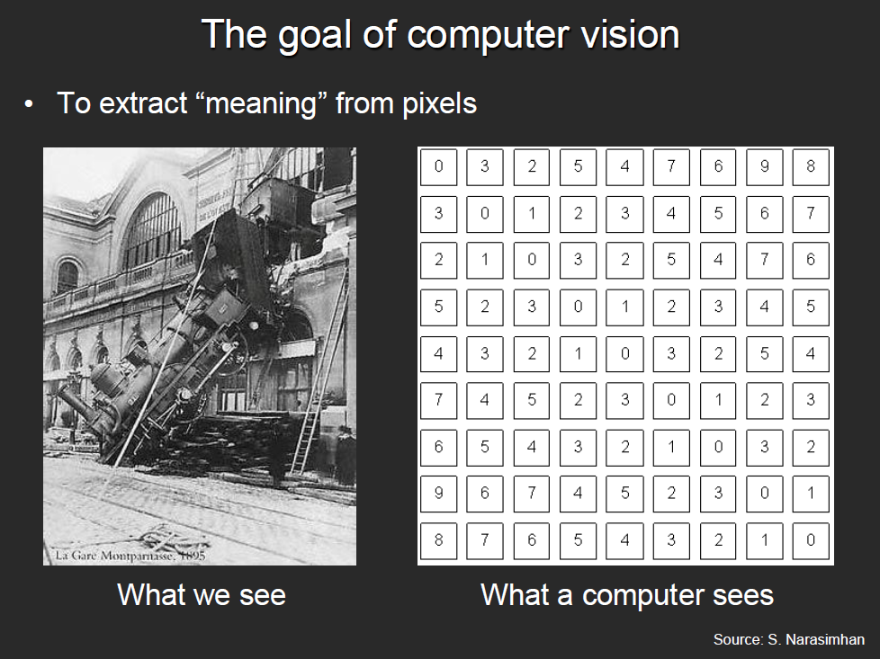
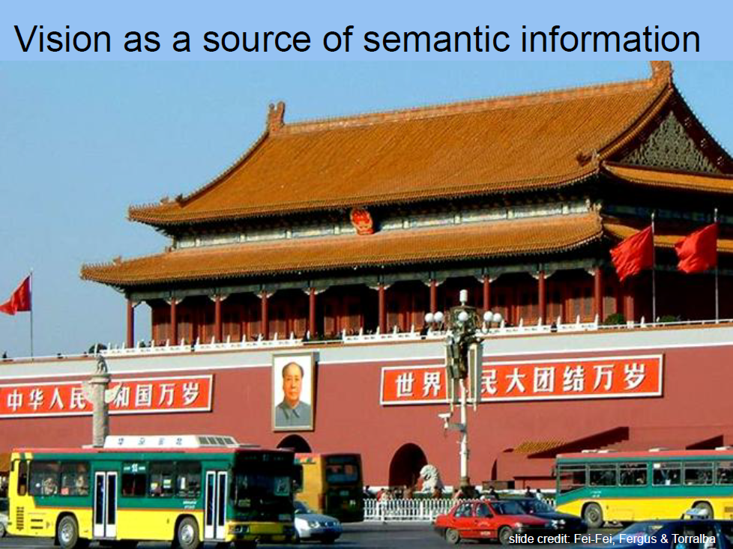
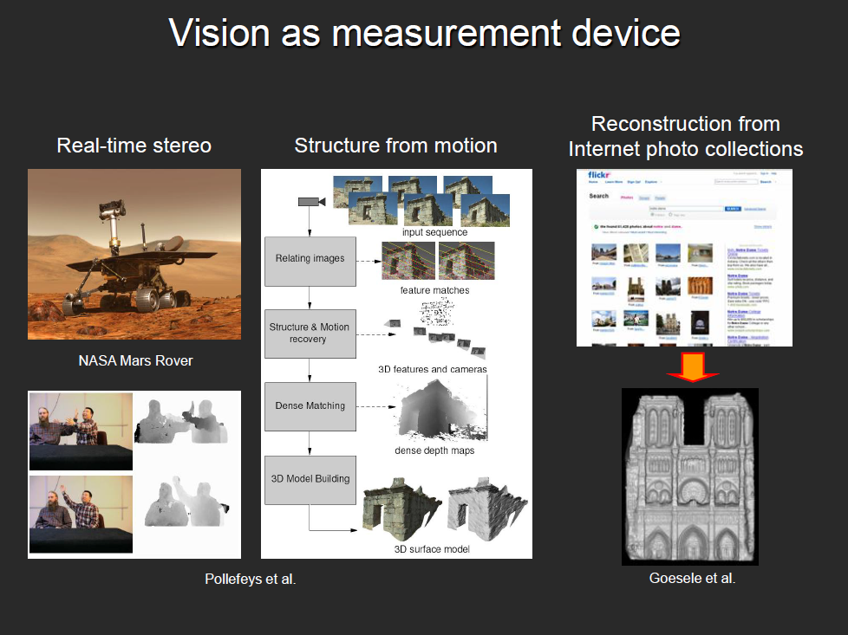
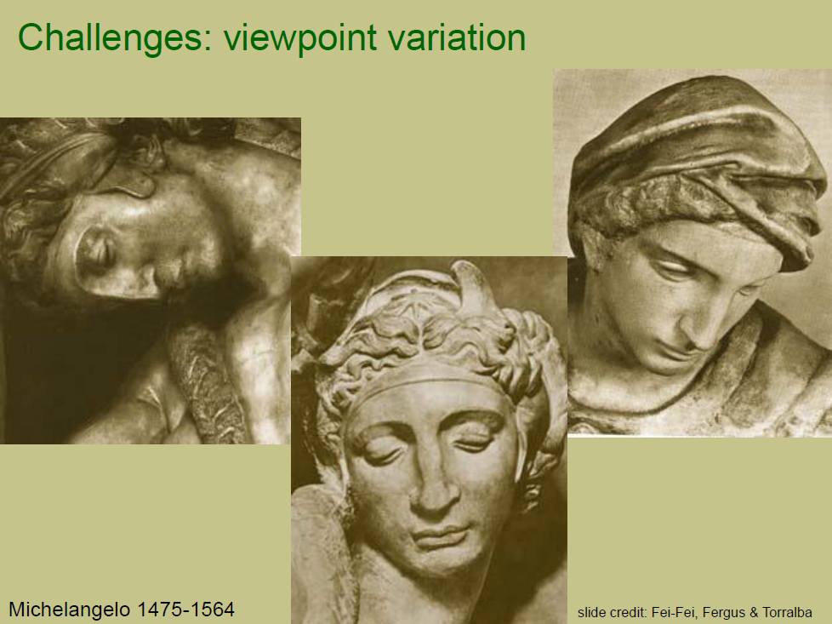
What we covered last time
Our focus in this course
Object Recognition
Object Detection
Depth from single image
Image pre-processing
Advantage of CNN over MLP
Local connectivity
Parameter sharing
Efficient runtime and storage
Different layers in CNN
Convolutional layer
ReLU
Pooling
Fully connected layer

Slide 3
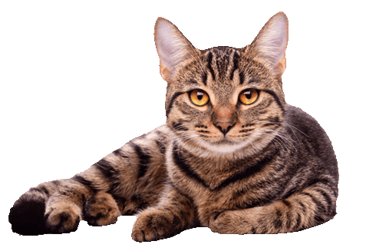
Object Recognition
Image classification: A core problem in computer vision
(assume given set of discrete labels) {dog, cat, truck, plane, ...}
CAT
Slide credit: cs213n@stanford

Slide 4
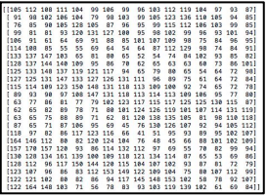
Object Recognition
The Problem: Semantic Gap
What the computer sees
An image is just a big grid of numbers between [0, 255]:
e.g. 800 x 600 x 3 (3 channels RGB)
Slide credit: cs213n@stanford

Slide 5
Object Recognition
Challenges: Viewpoint variation
All pixels change when the camera moves!
Slide credit: cs213n@stanford

Slide 6
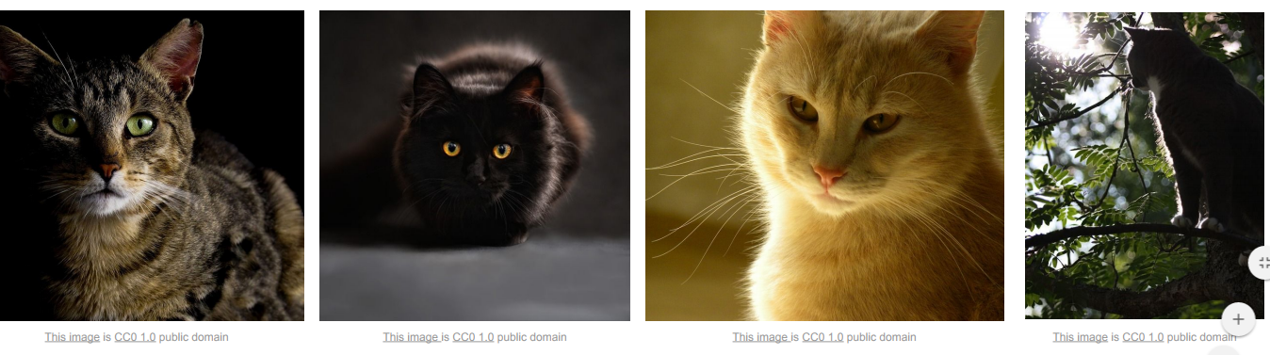
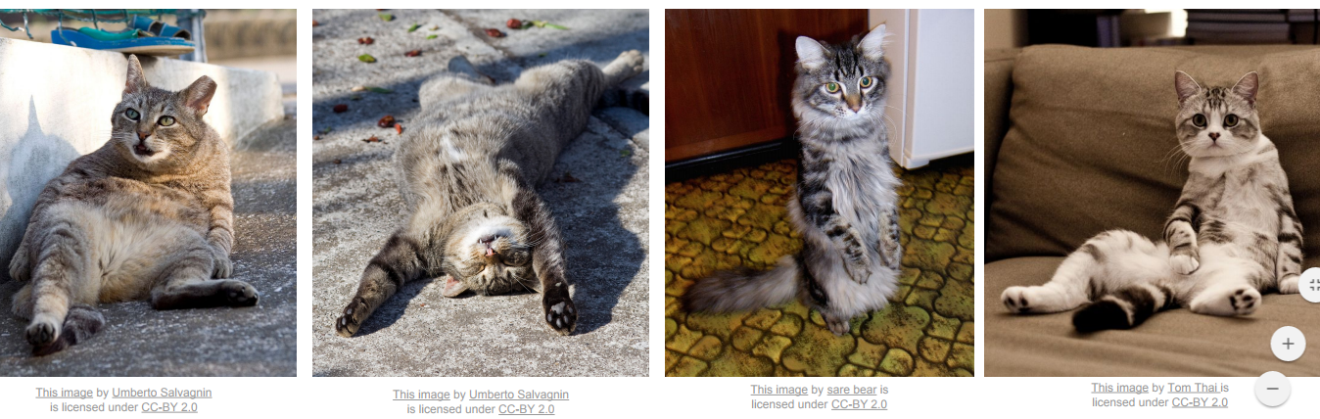
Object Recognition: Challenges
Illumination
Deformation
Slide credit: cs213n@stanford

Slide 7
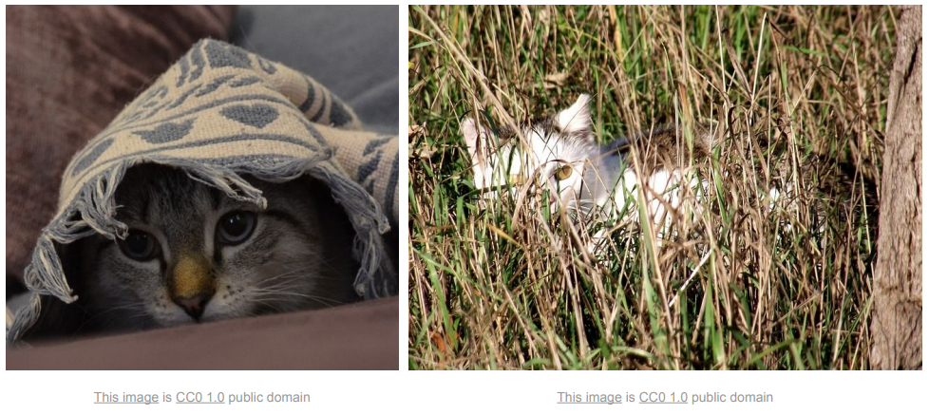
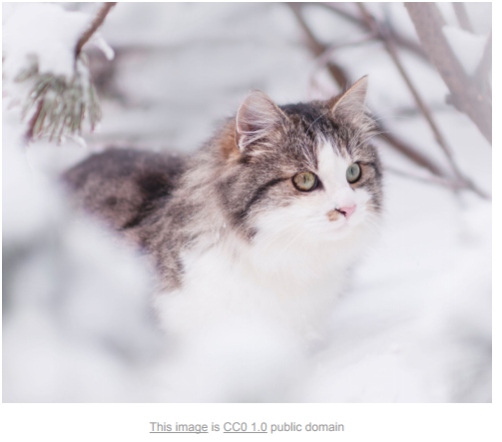
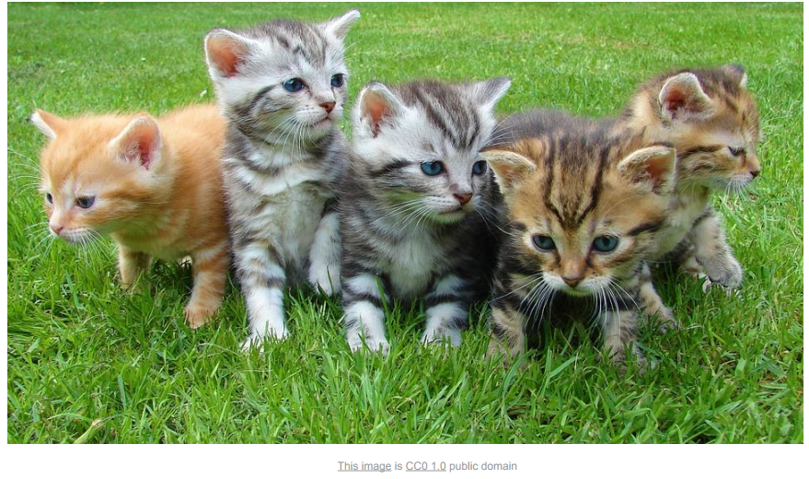
Object Recognition: Challenges
Occlusion and Background clutter
Intraclass variation
Slide credit: cs213n@stanford

Slide 8
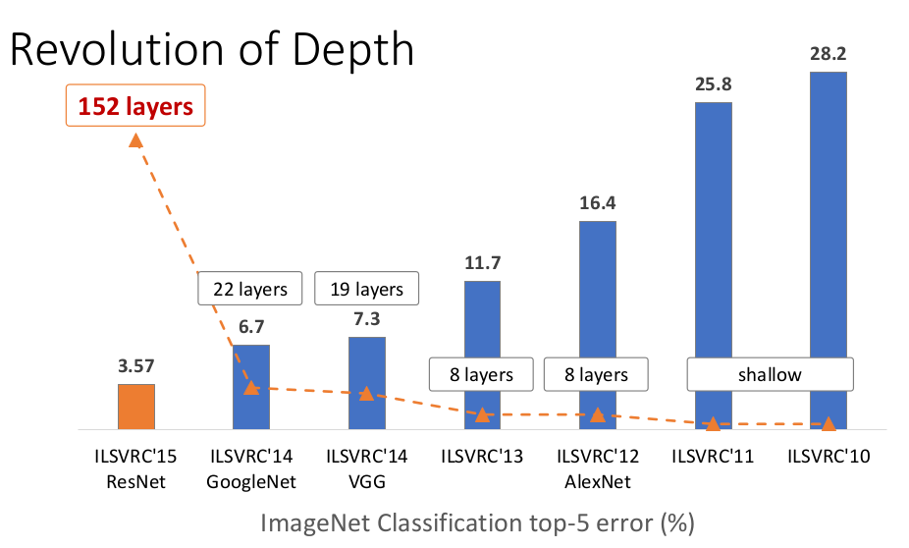
Object Recognition
Deep learning
LeNet by Lecun et al. 1998 (MNIST)
AlexNet by Krish et al. NIPS’ 12
VGGNet by Simonyan et al. ICLR’ 15
GoogLeNet by Szegedy et al. CVPR’ 15
ResNet by He et al., CVPR’ 16
Slide credit: Kaiming he

Slide 9
Case study of following CNN architectures
LeNet
AlexNet
VGG
GoogLeNet
ResNet

Slide 10
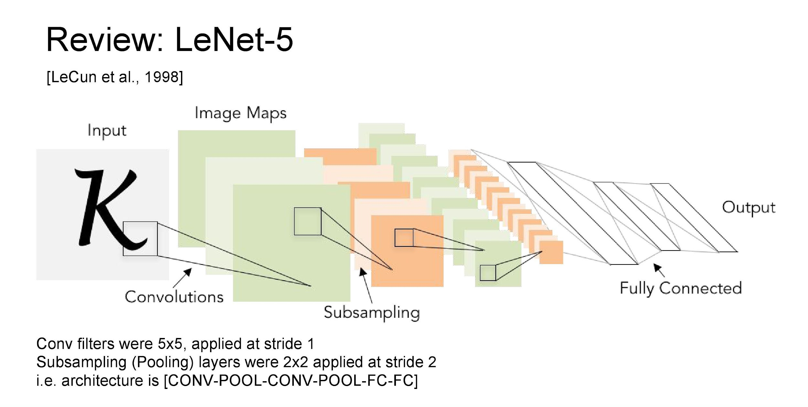


Slide 11
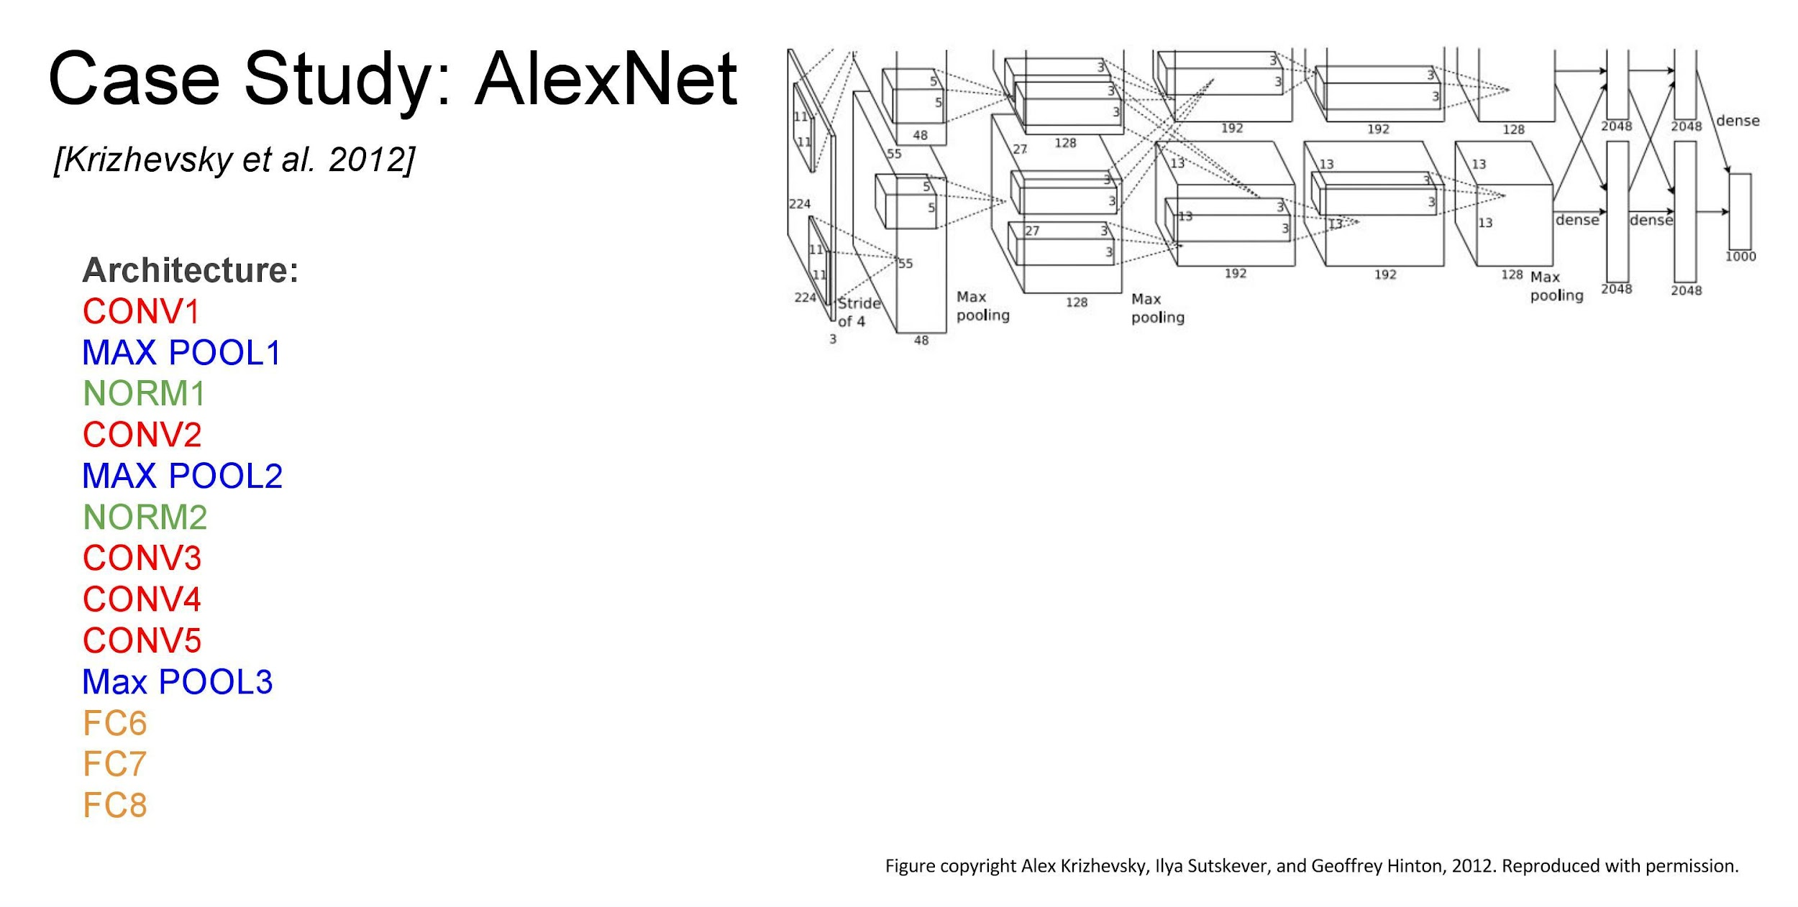
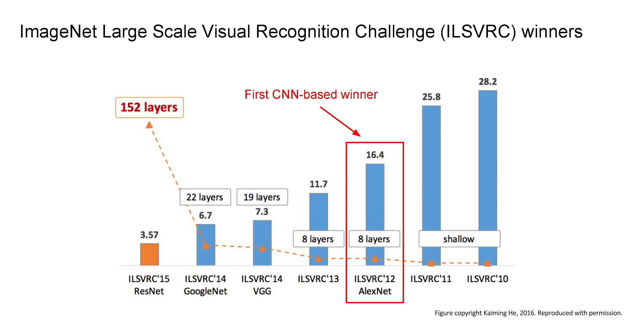

Slide 12
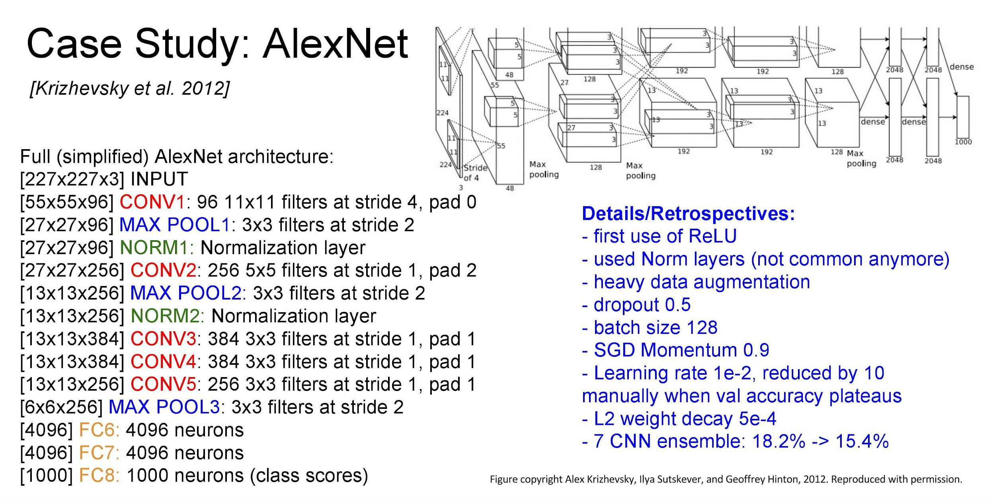
Notes:
Local response normalization to limit unbounded activation and for lateral inhibition
https://towardsdatascience.com/difference-between-local-response-normalization-and-batch-normalization-272308c034ac#:~:text=Local%20Response%20Normalization%20(LRN)%20was,and%20sigmoid%20at%20that%20time.&text=LRN%20is%20a%20non%2Dtrainable,a%20within%20a%20local%20neighborhood.

Slide 13
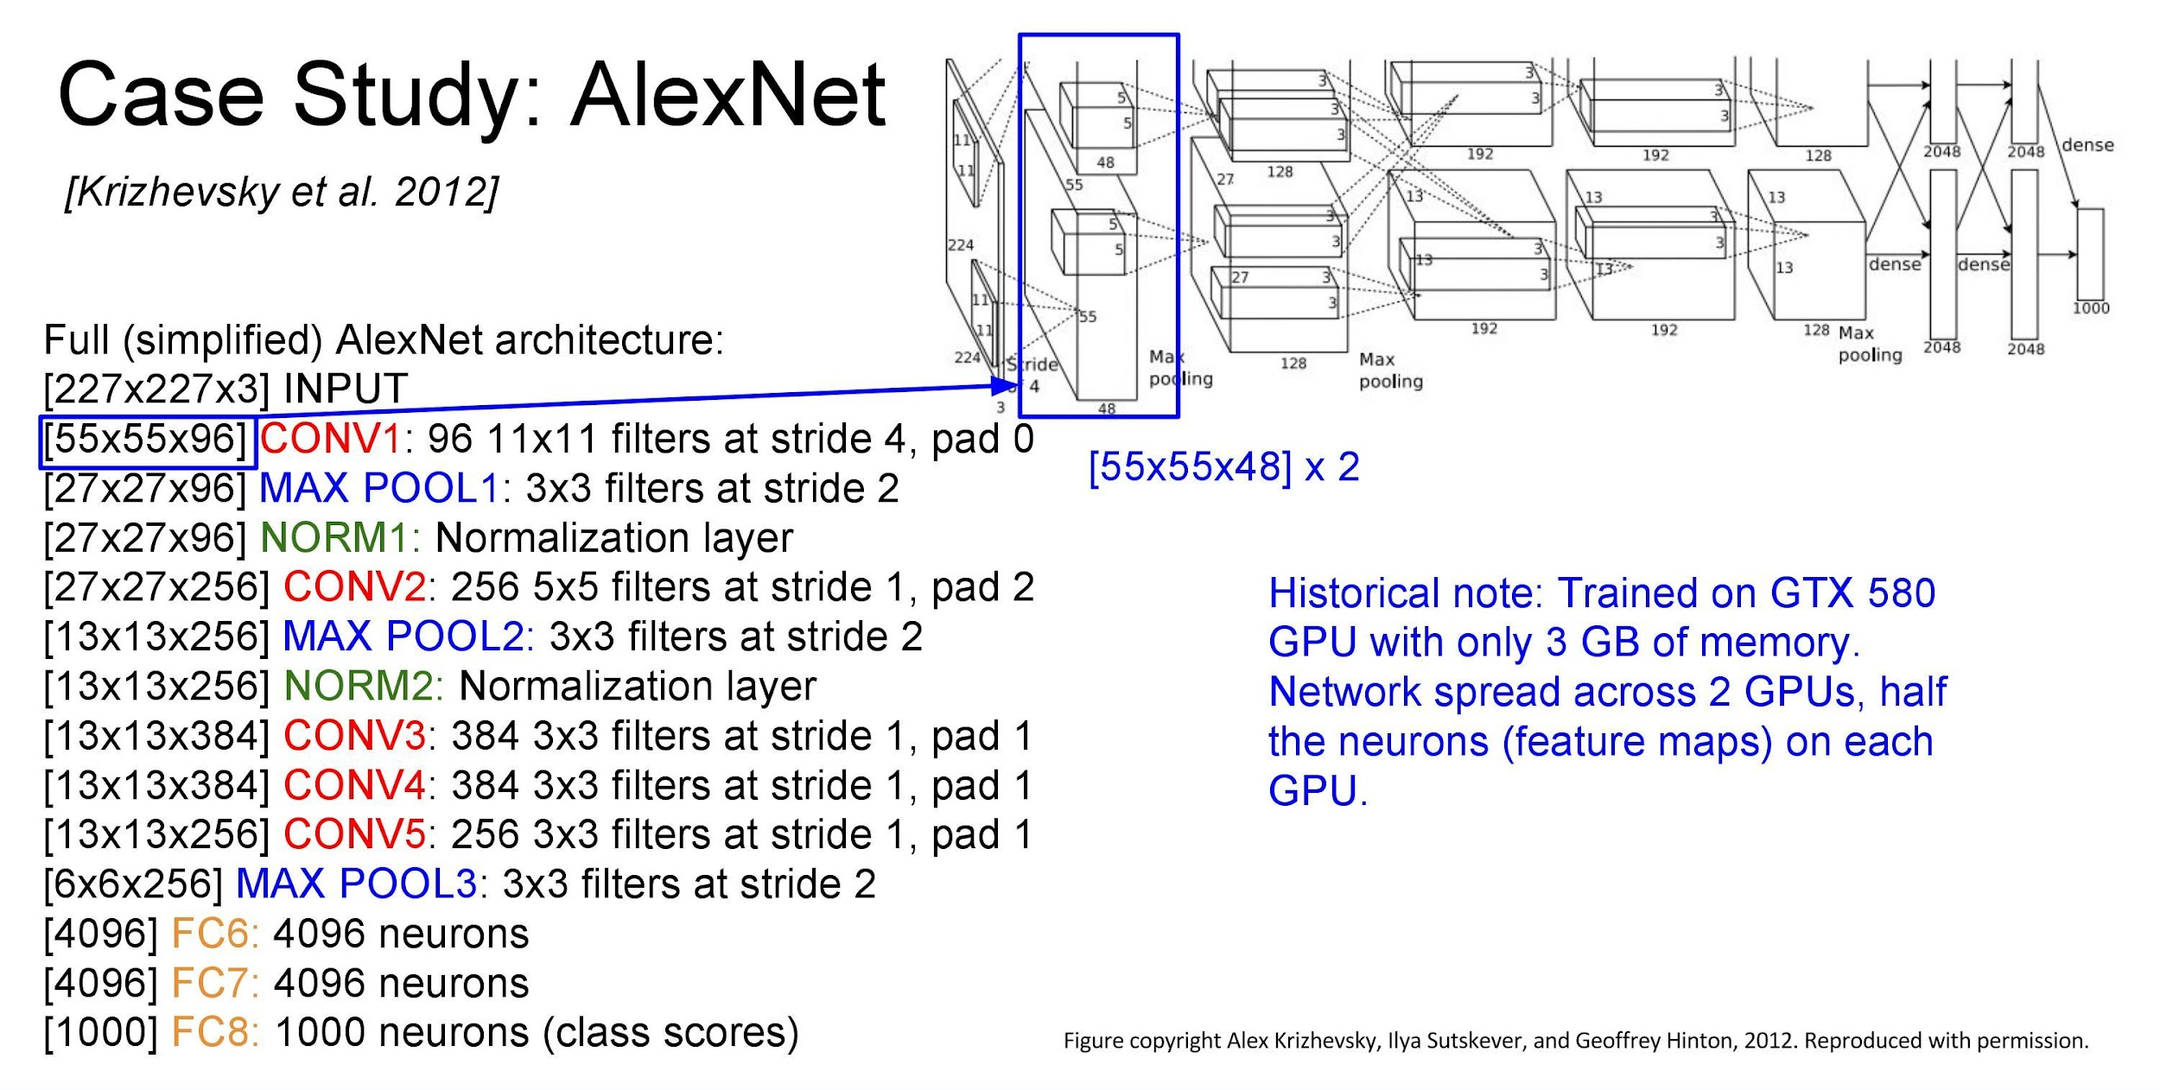

Slide 14
Note on Alexnet
Notice the use of filters of size 11x11 in the initial layer.
It increases the number of parameters that need to be trained
Recent CNNs use cascade of small filters of size 3*3 or 5*5.

Slide 15
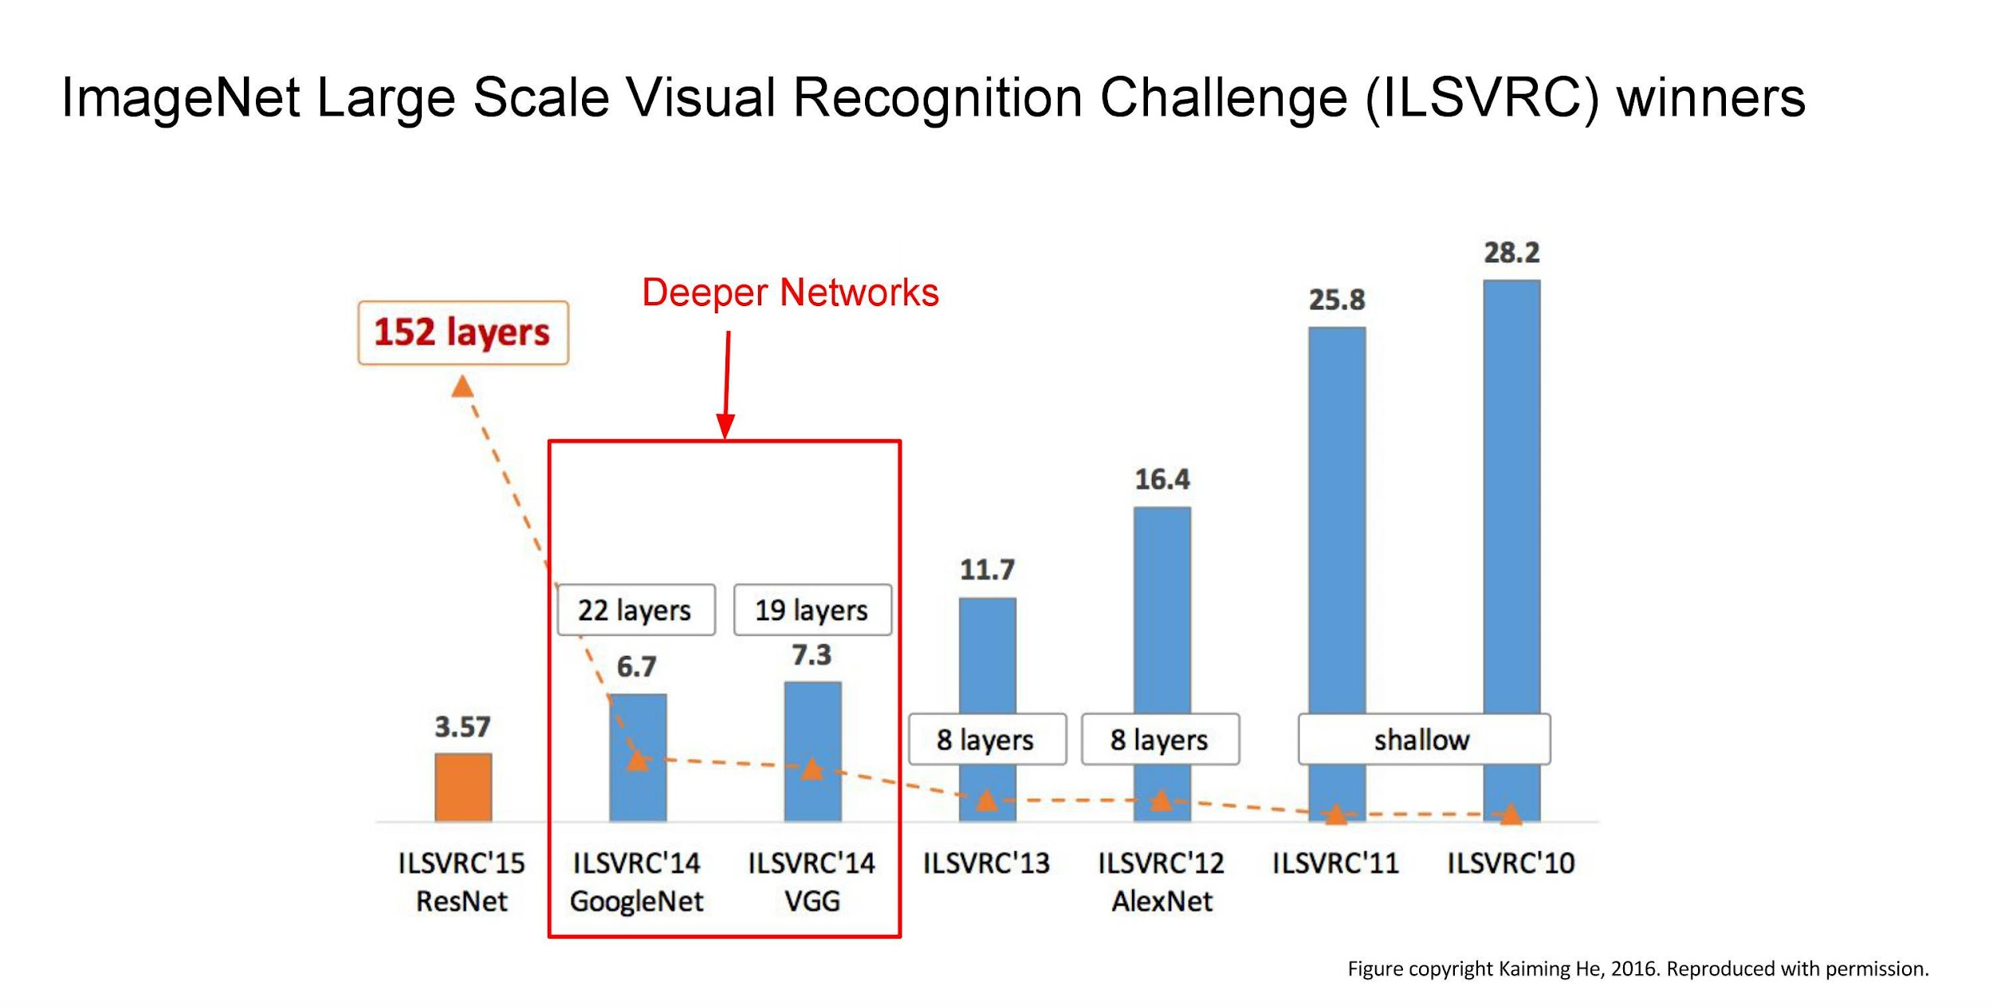

Slide 16
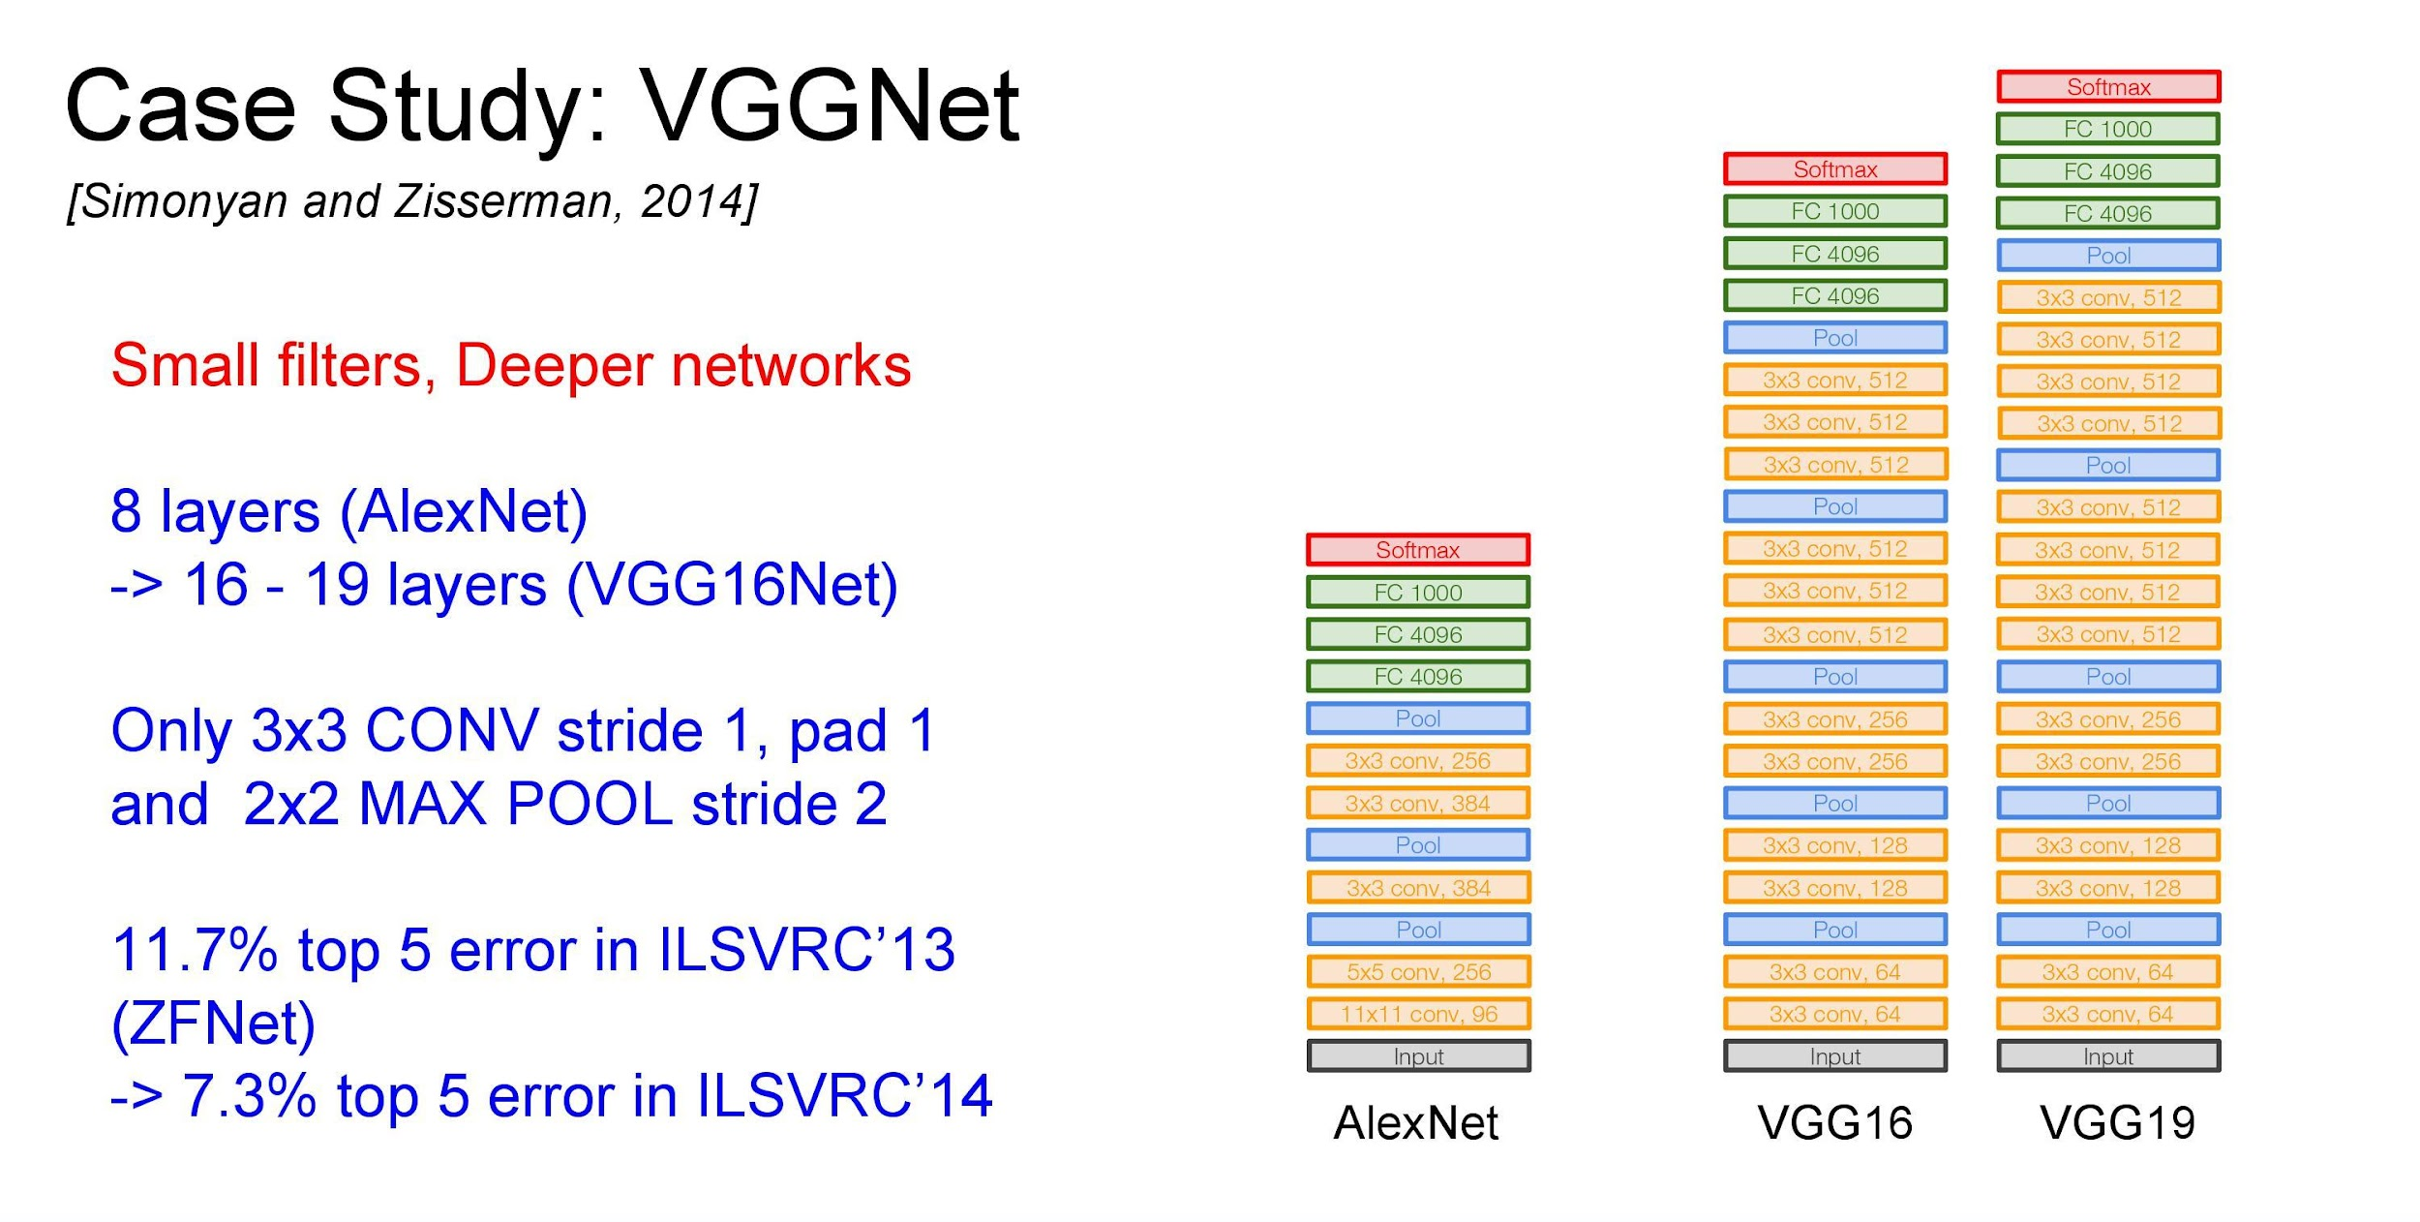

Slide 17
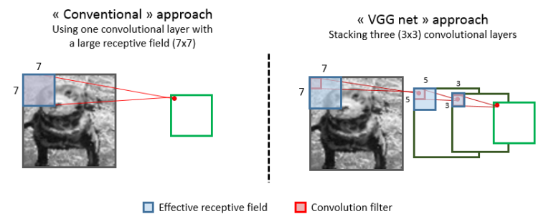
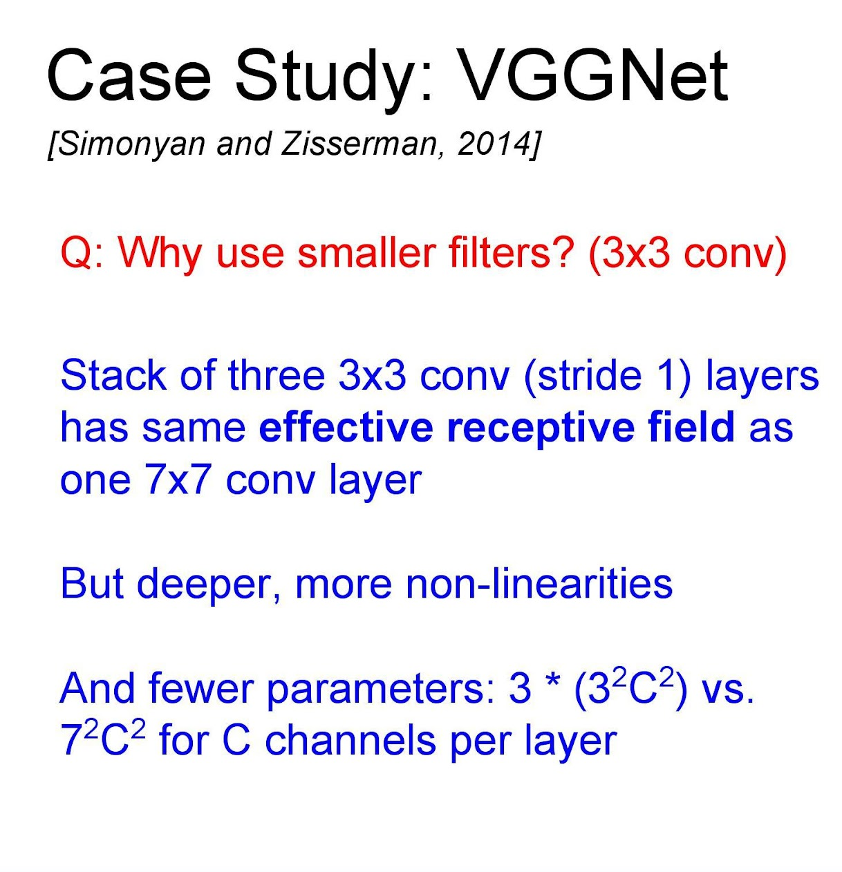

Slide 18
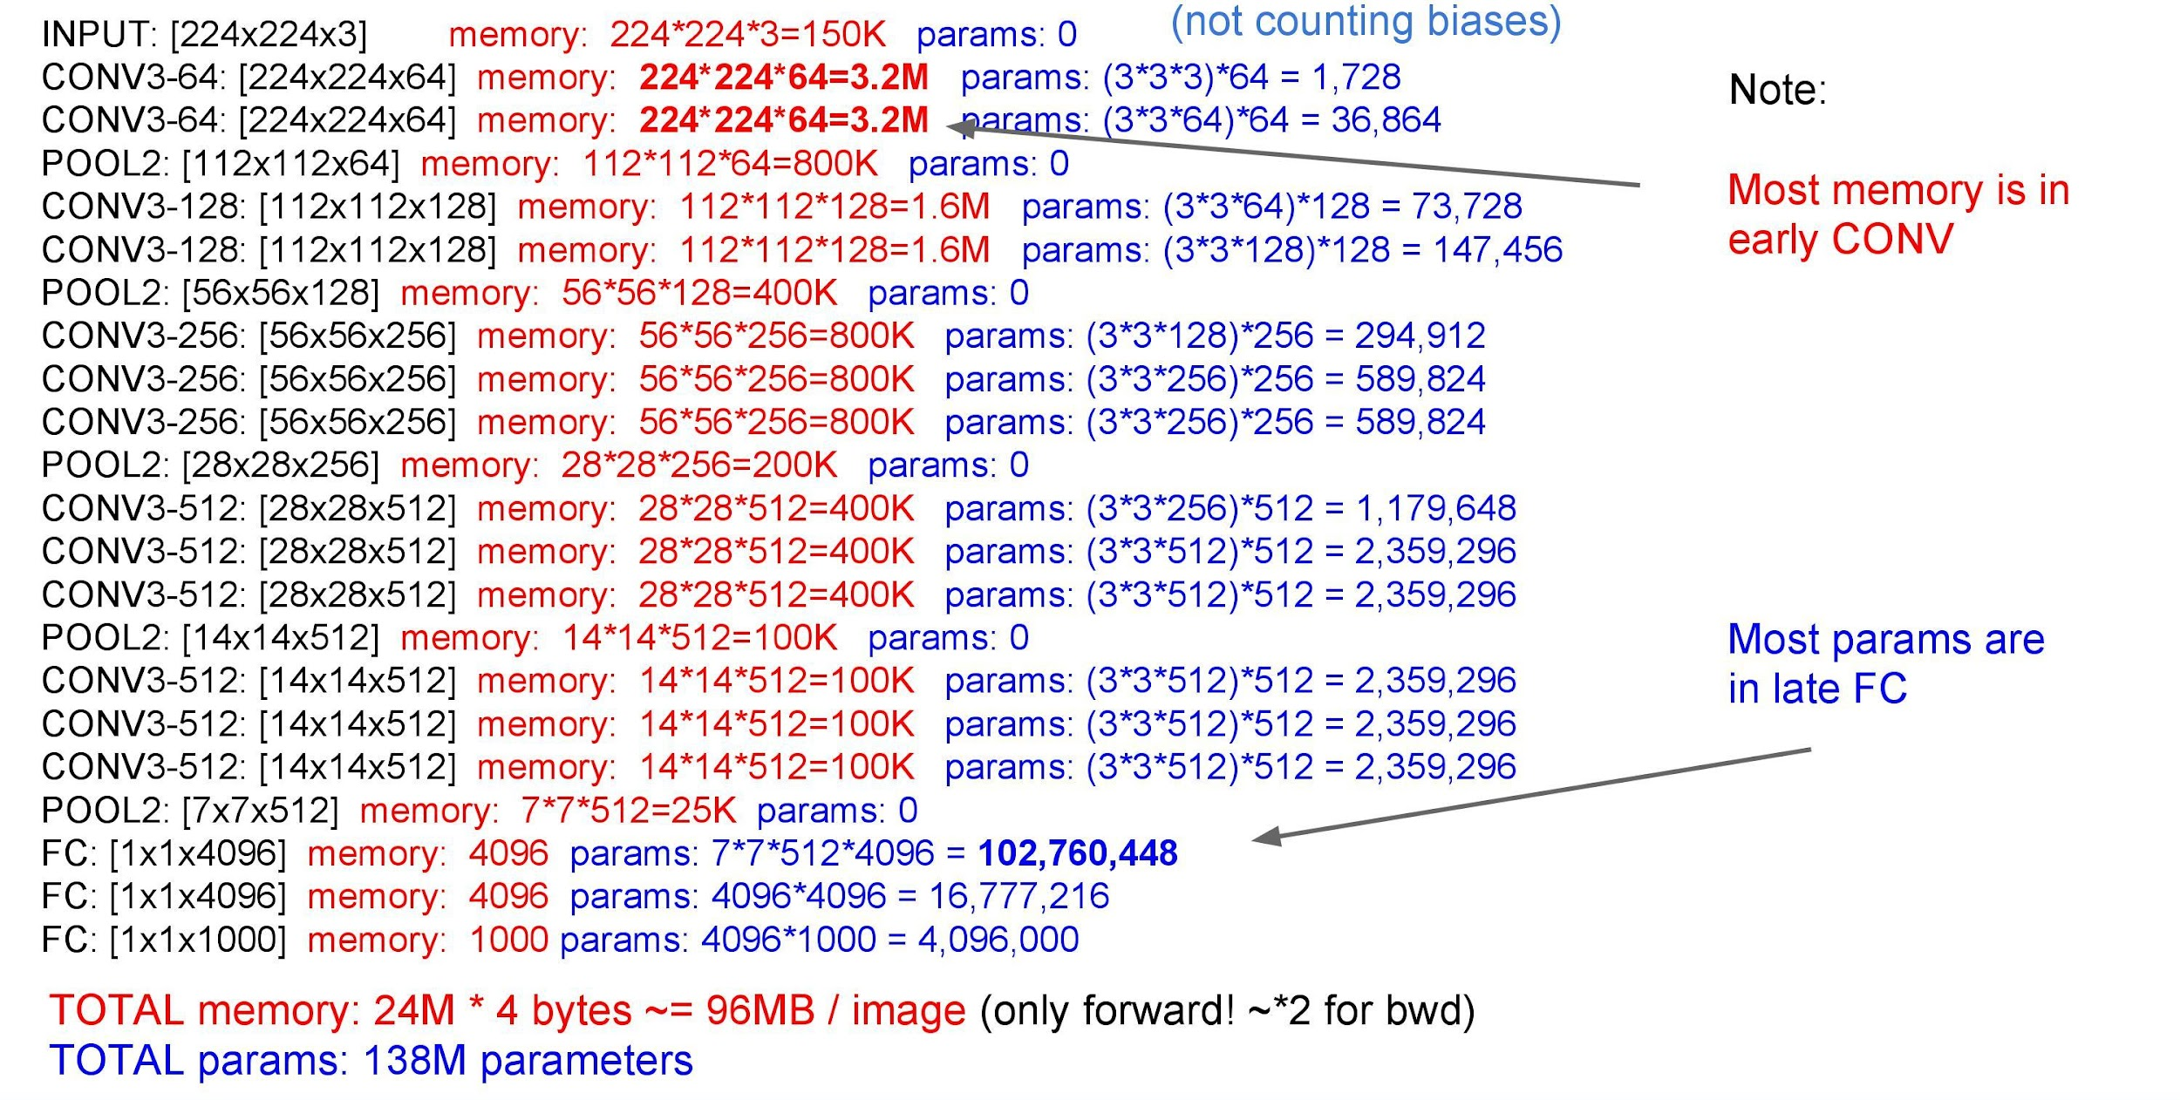

Slide 19
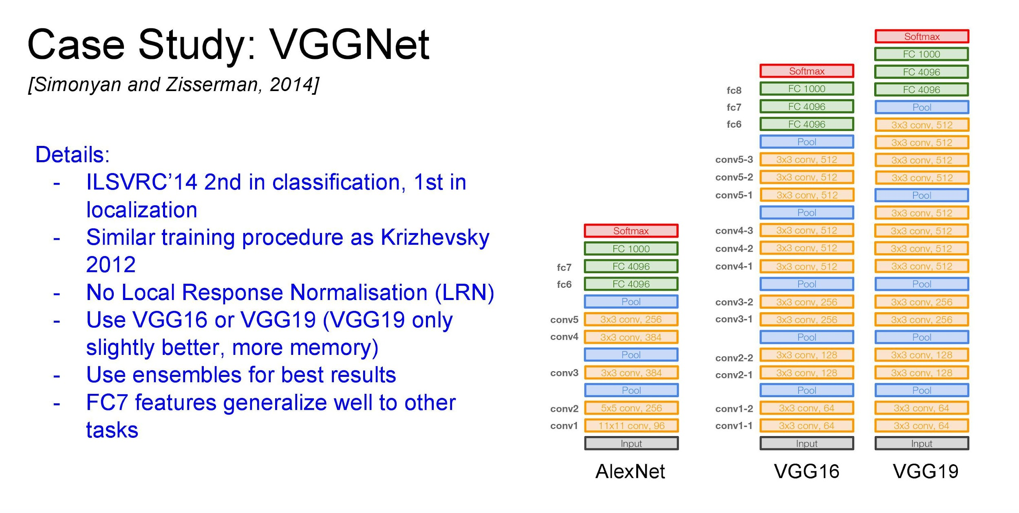

Slide 21
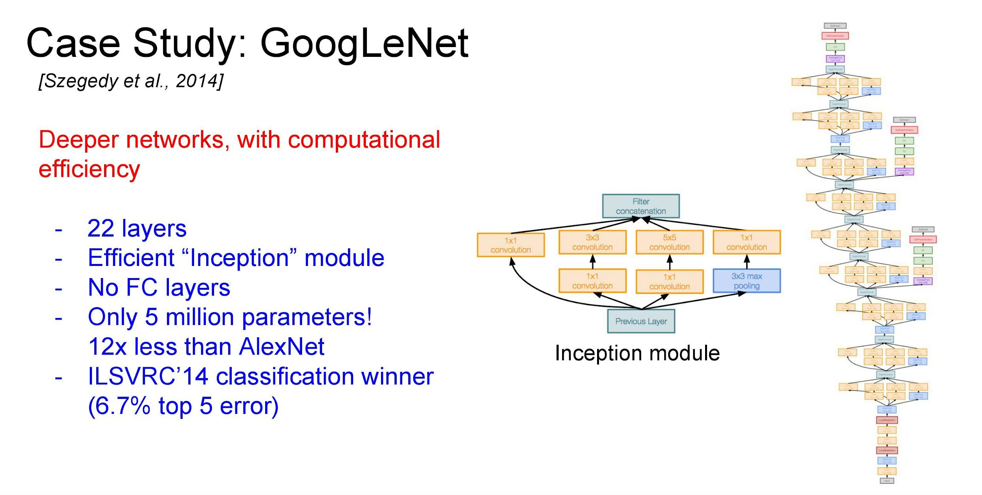

Slide 22
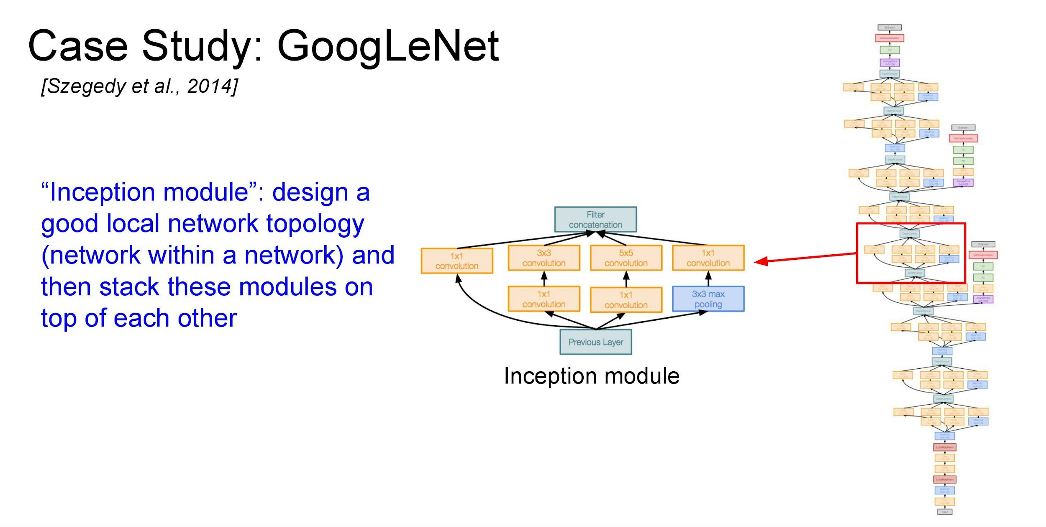

Slide 23
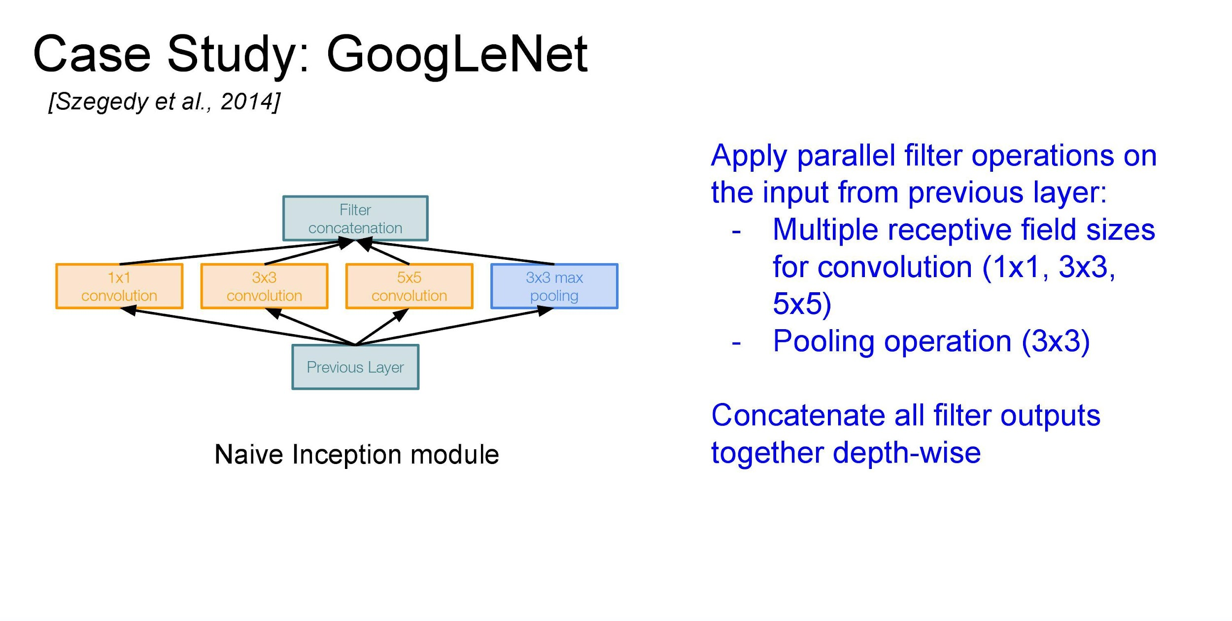

Slide 24
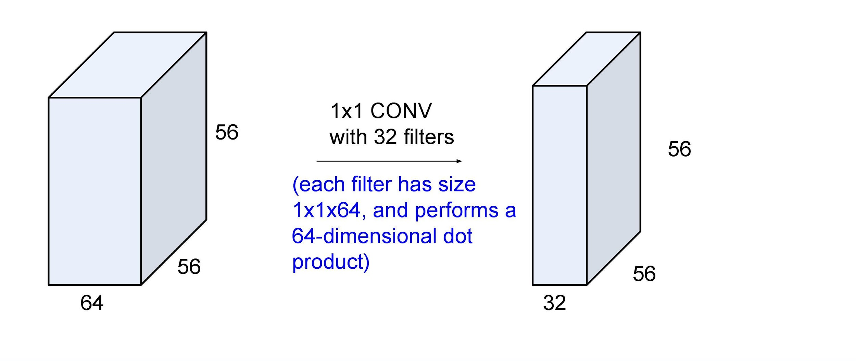
1x1 Convolutions

Slide 25
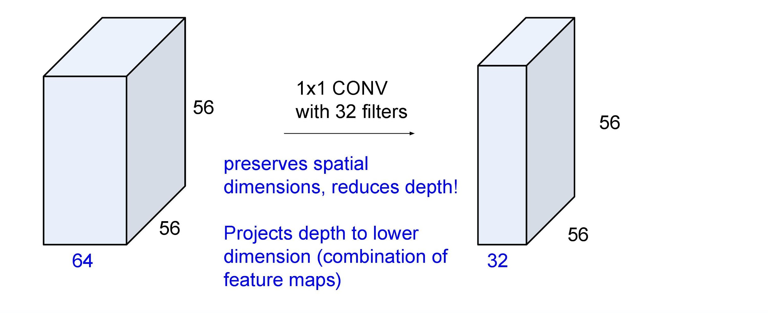
1x1 Convolutions

Slide 26
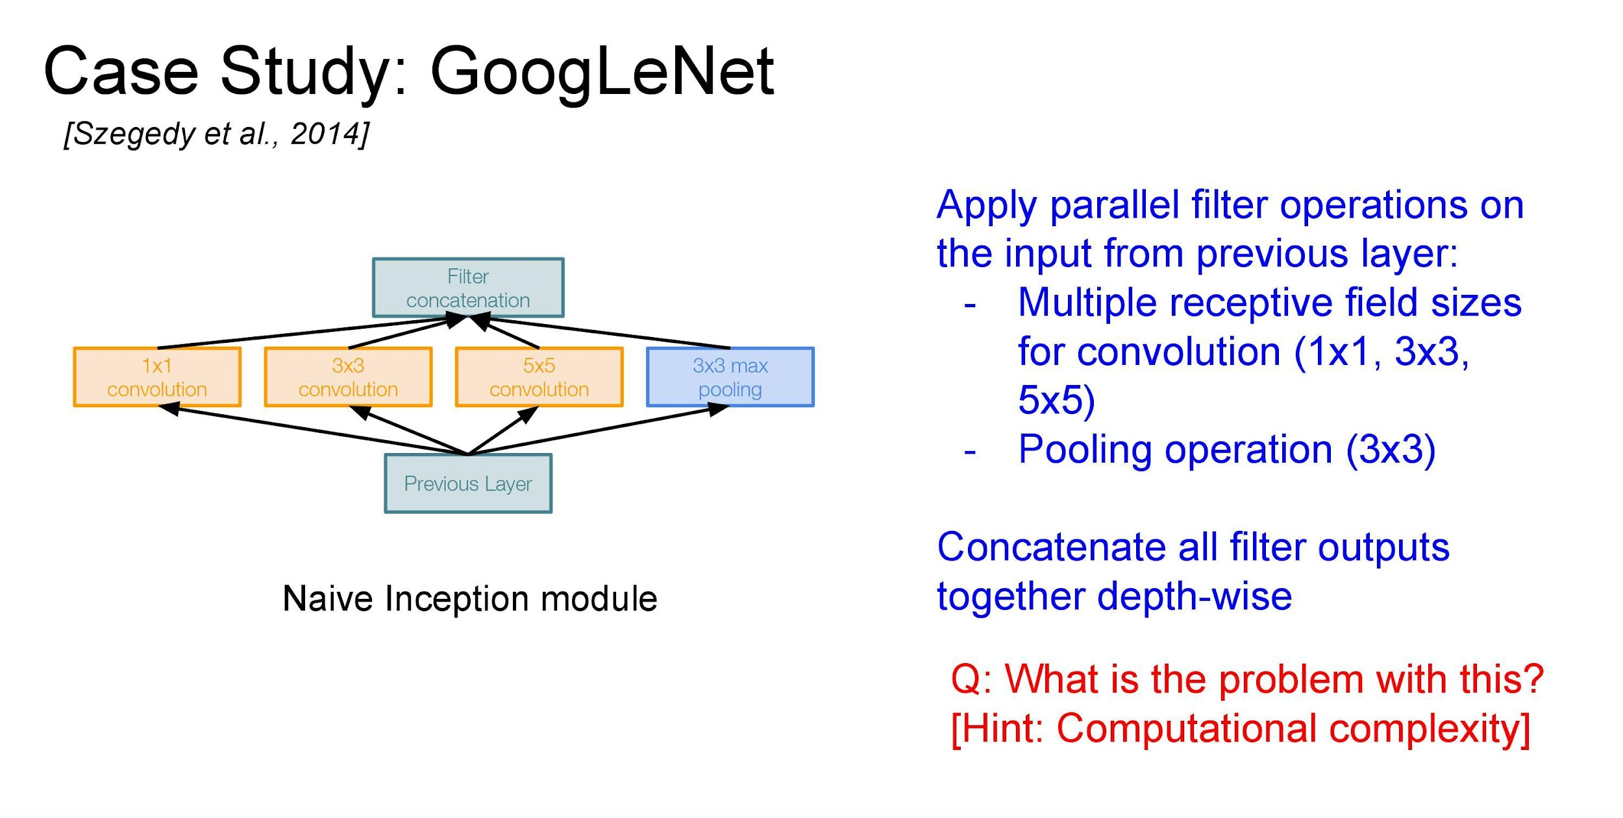

Slide 27
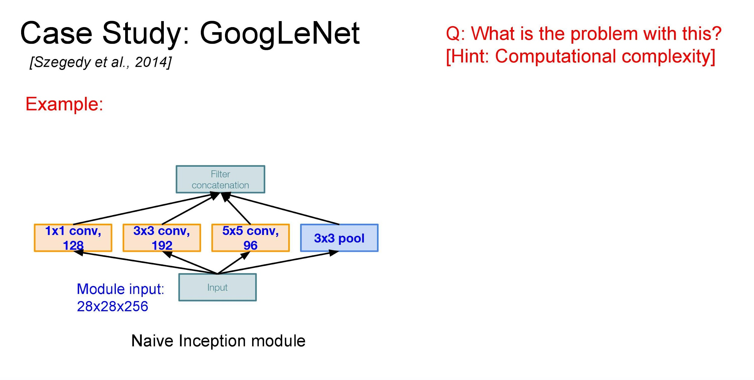

Slide 28
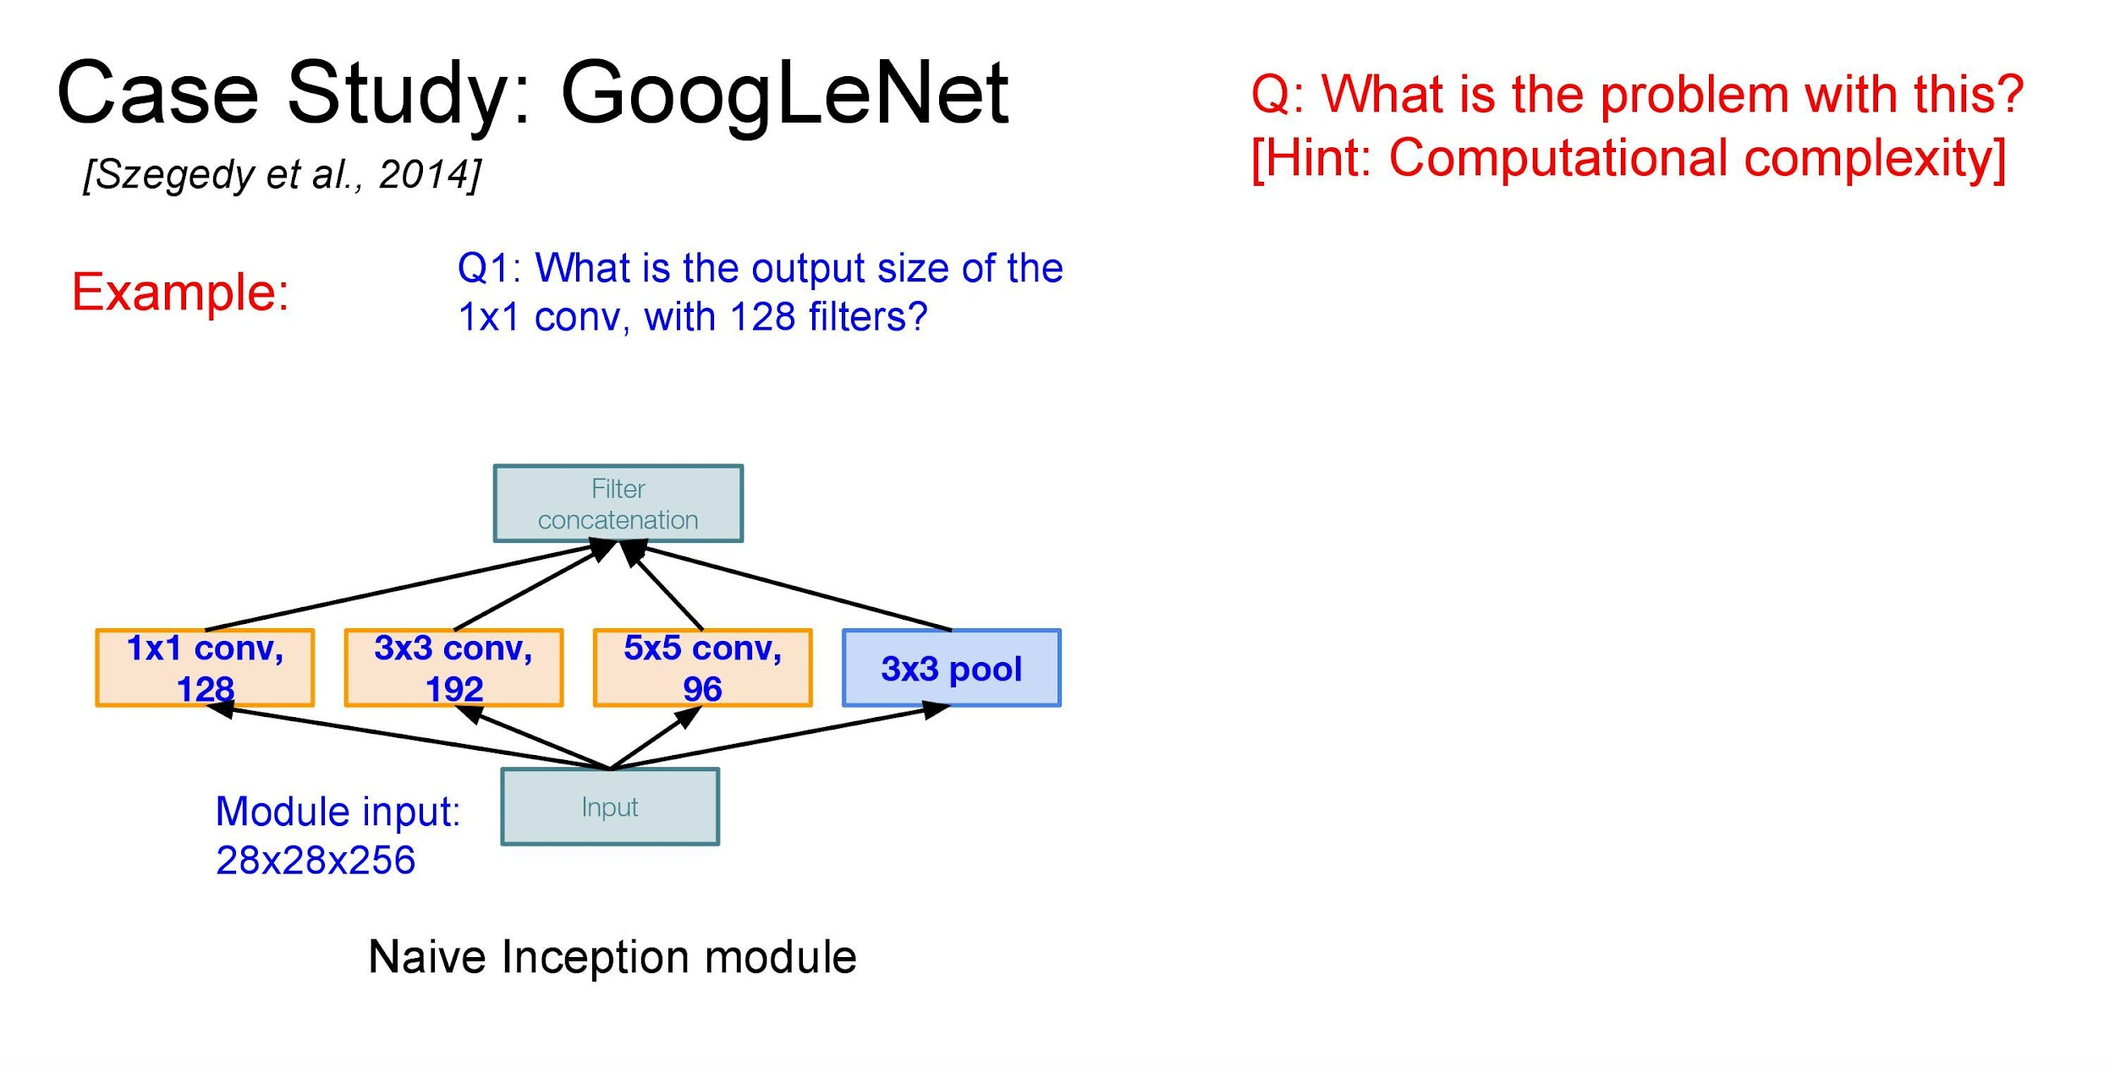

Slide 29
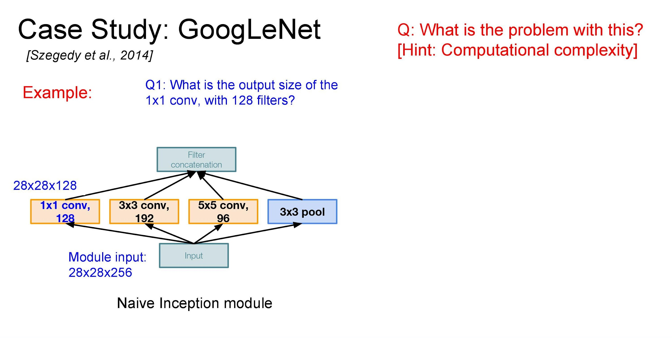

Slide 30
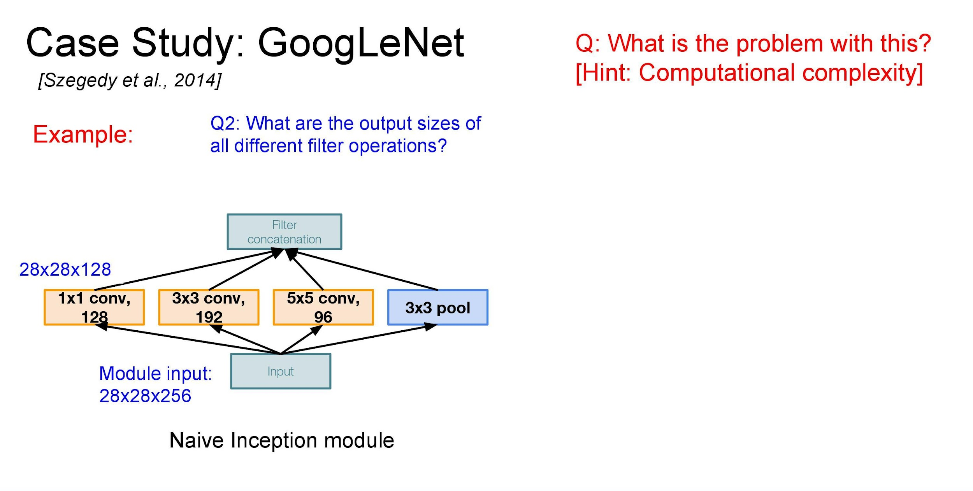

Slide 31
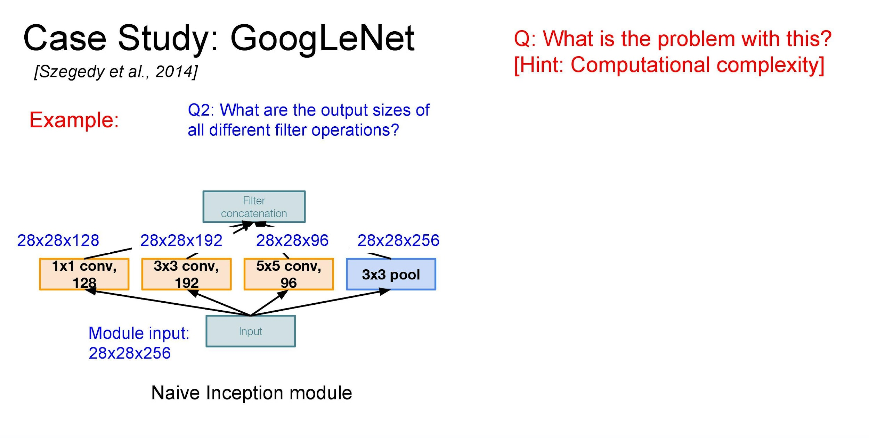

Slide 32
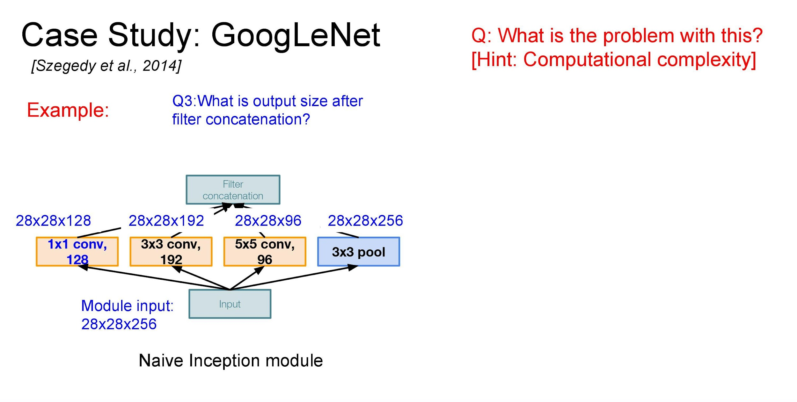

Slide 33
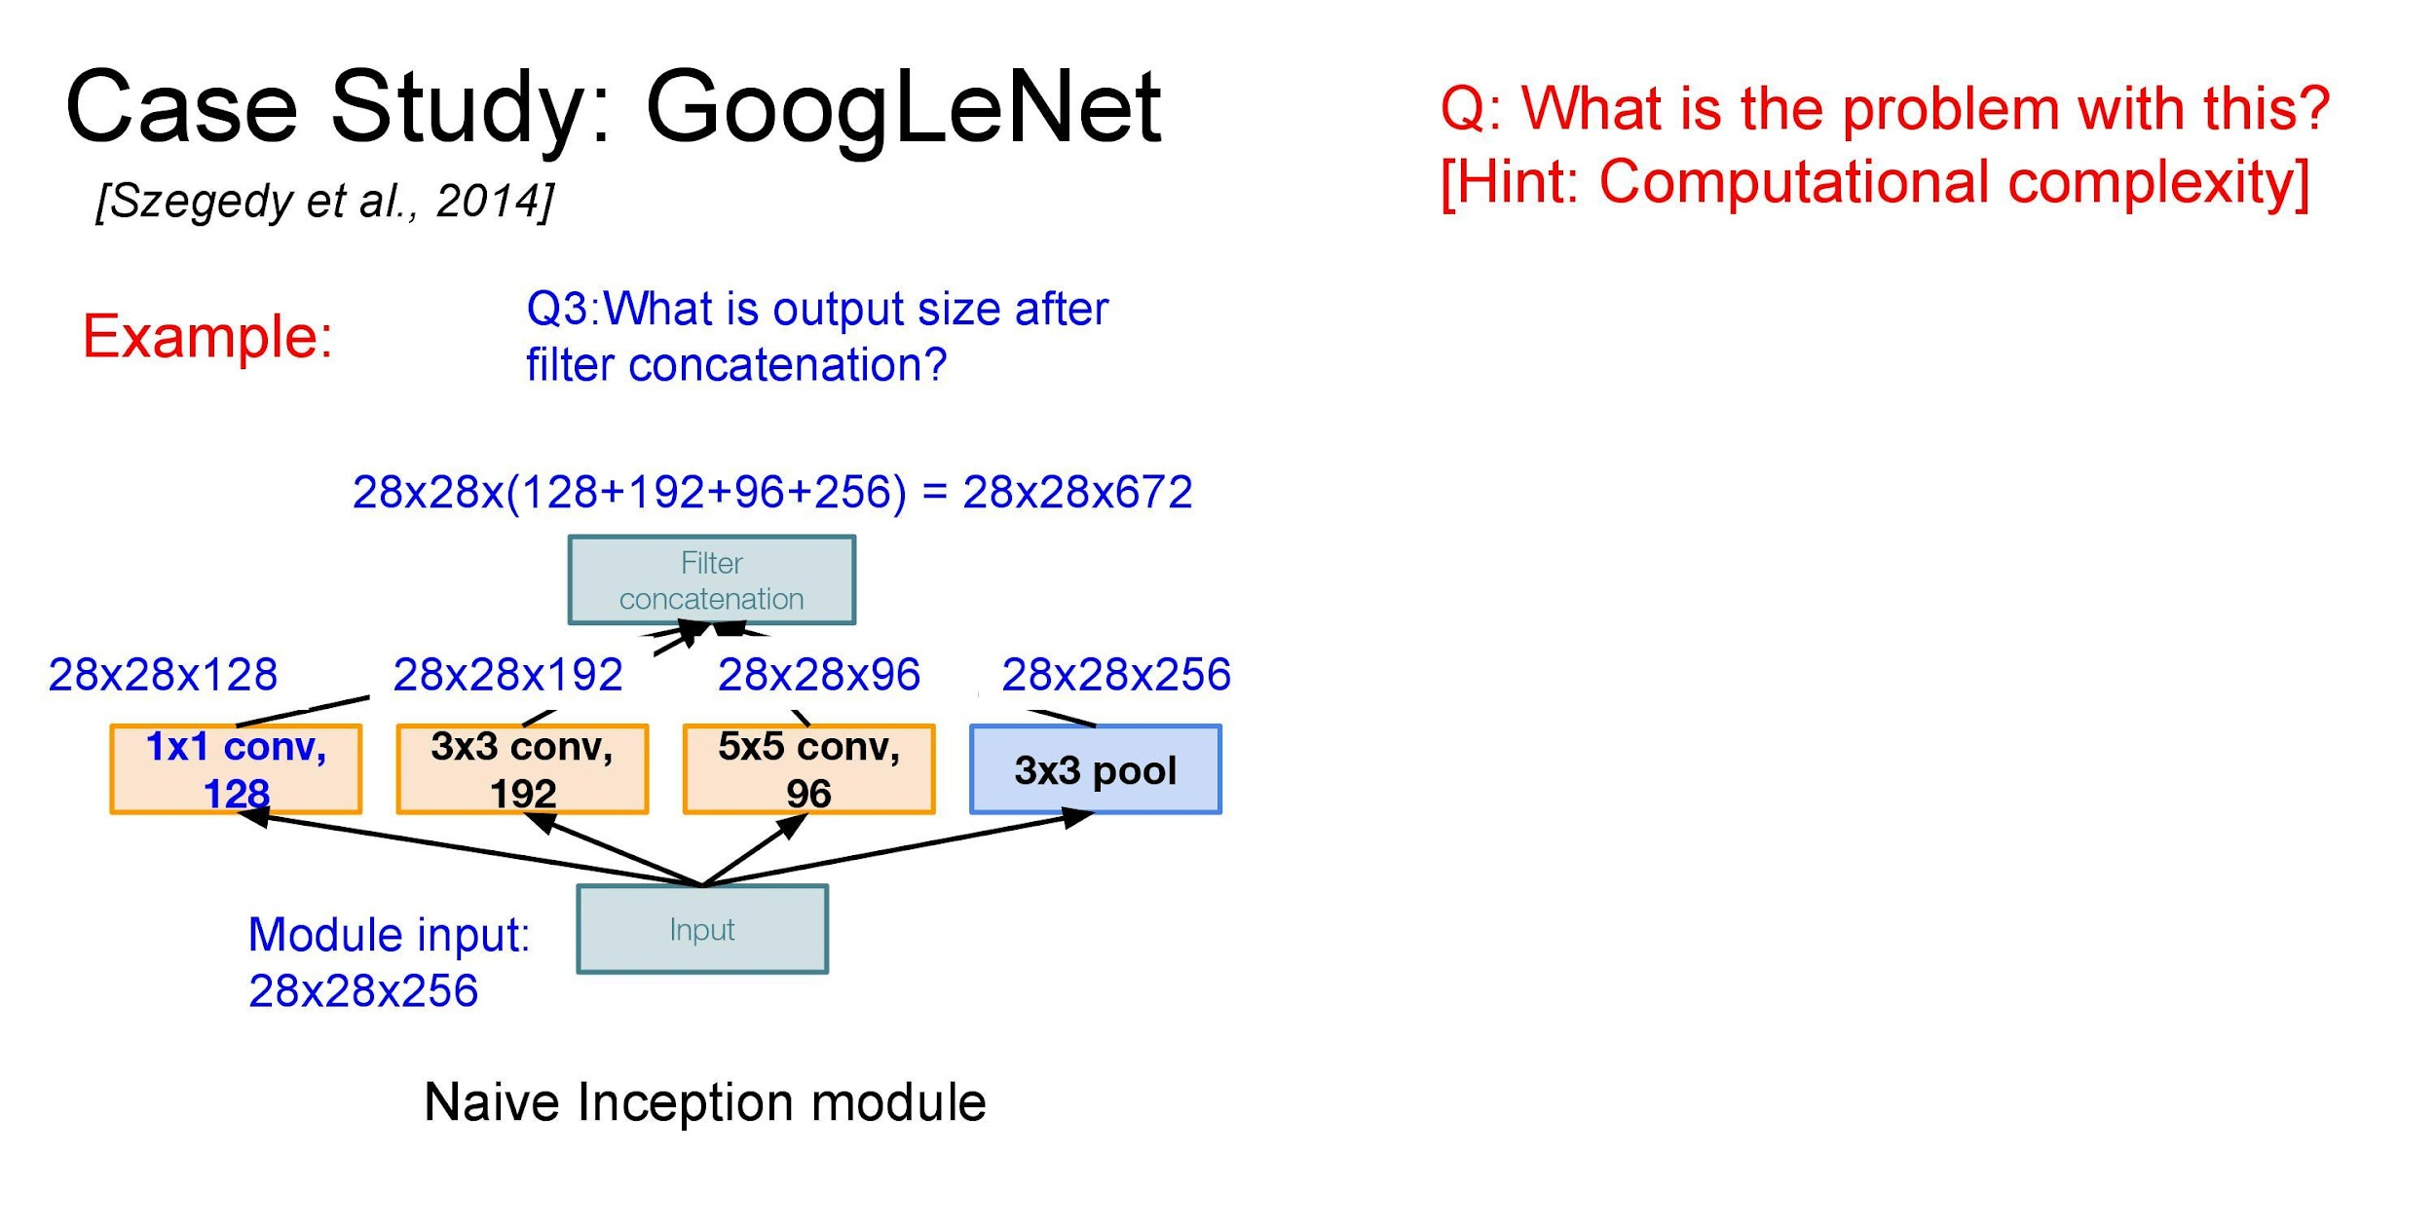

Slide 34
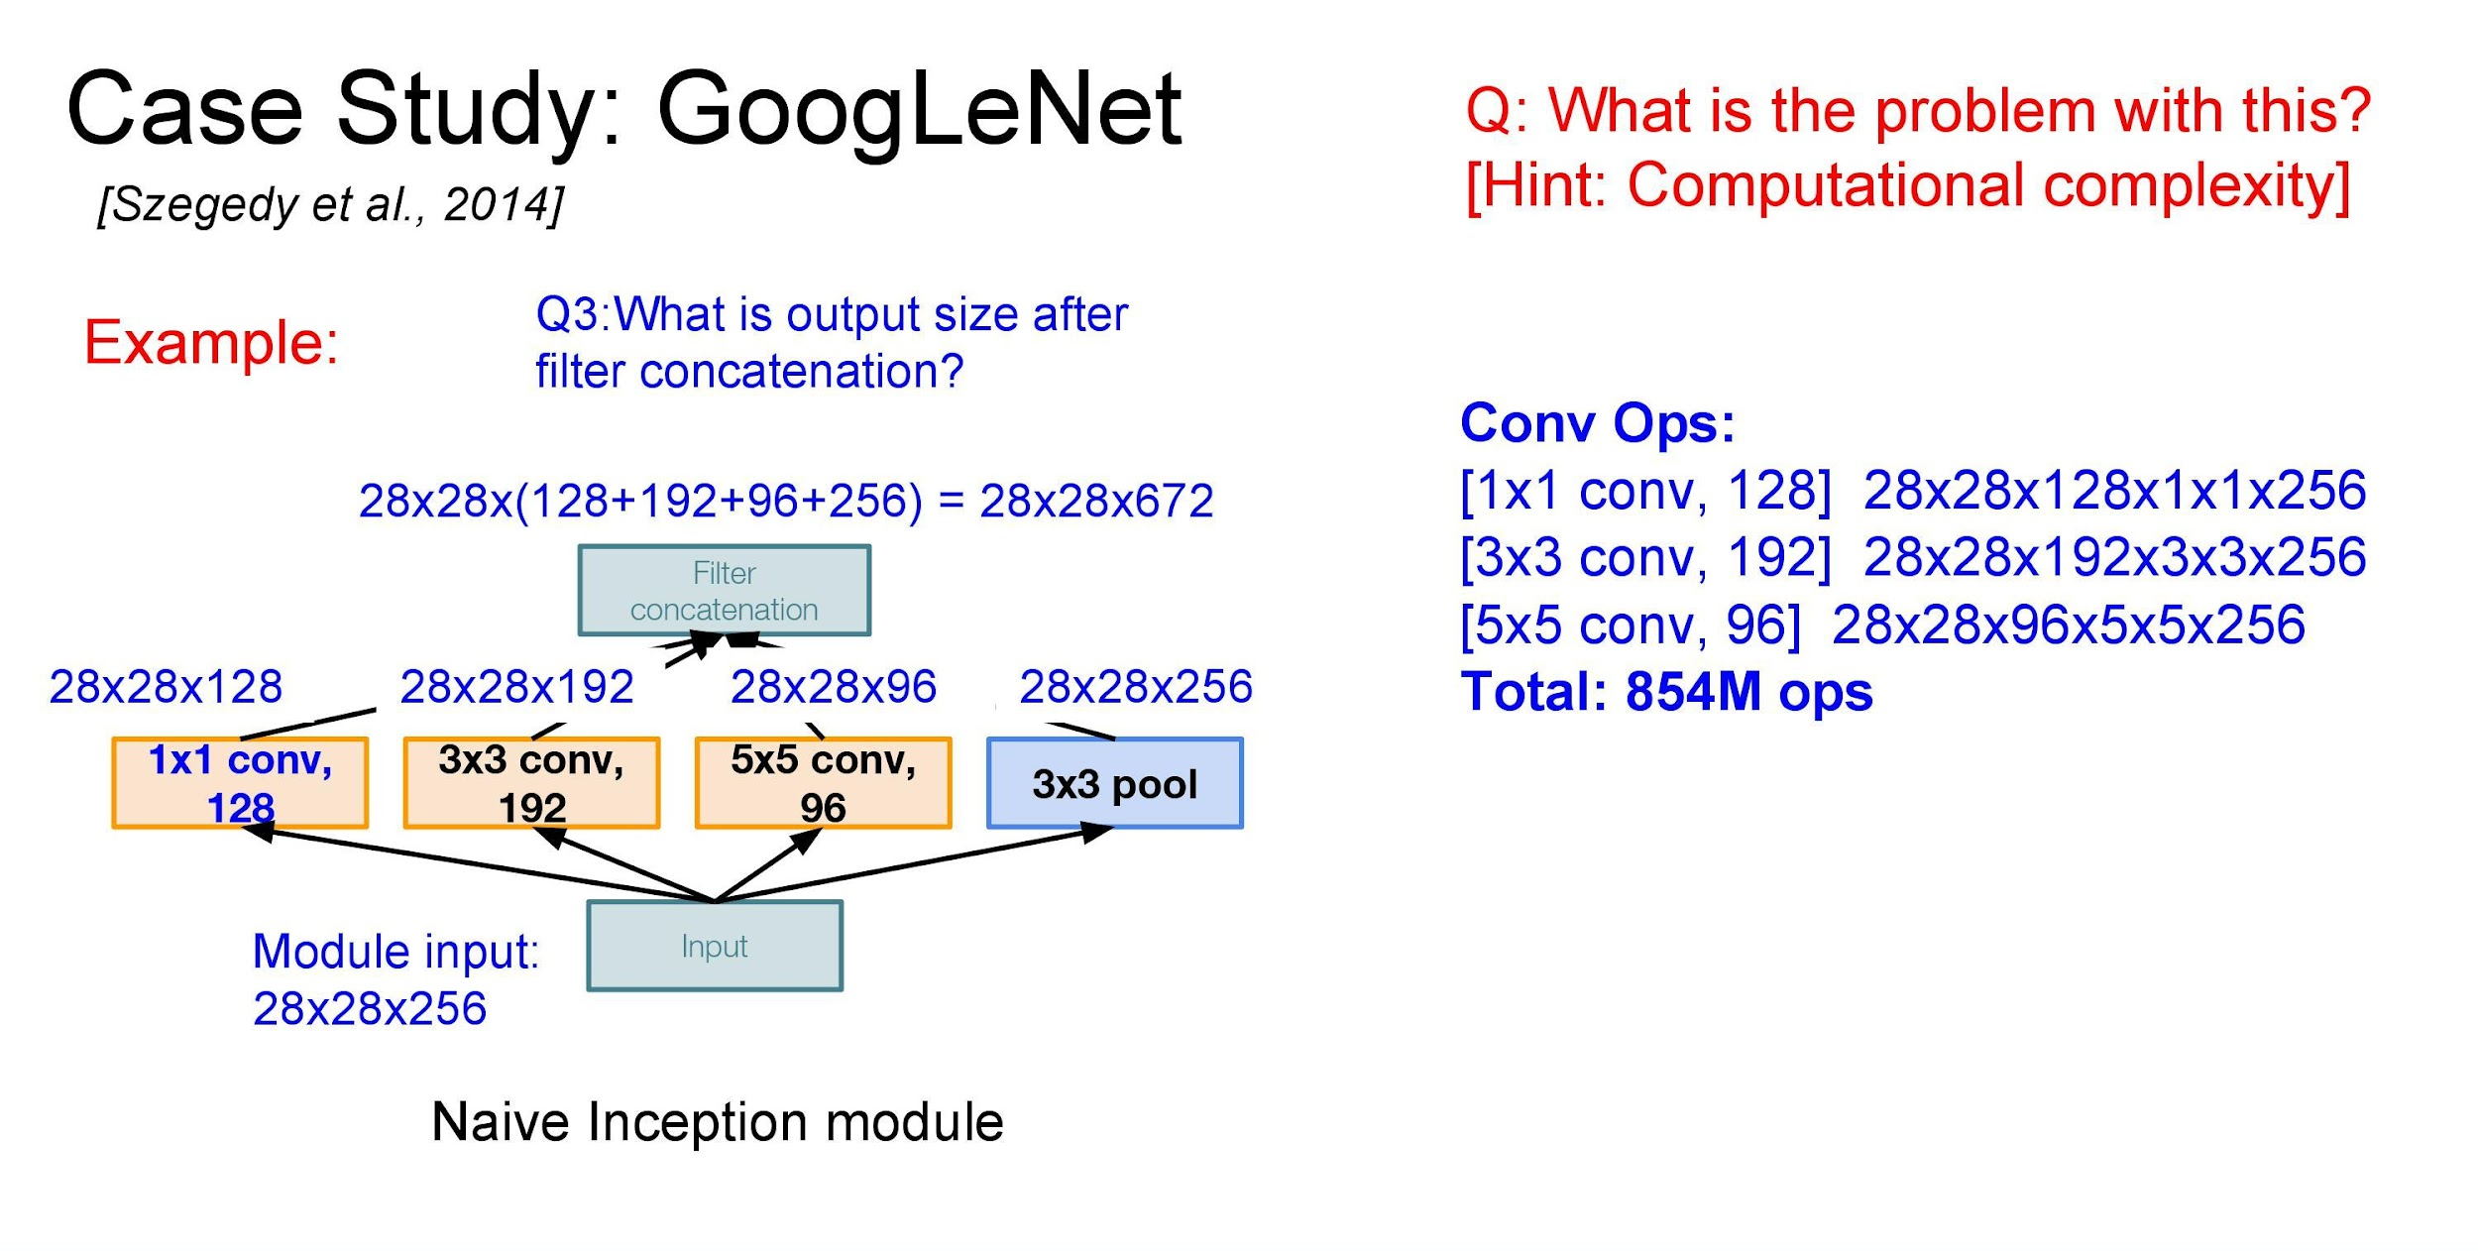

Slide 35
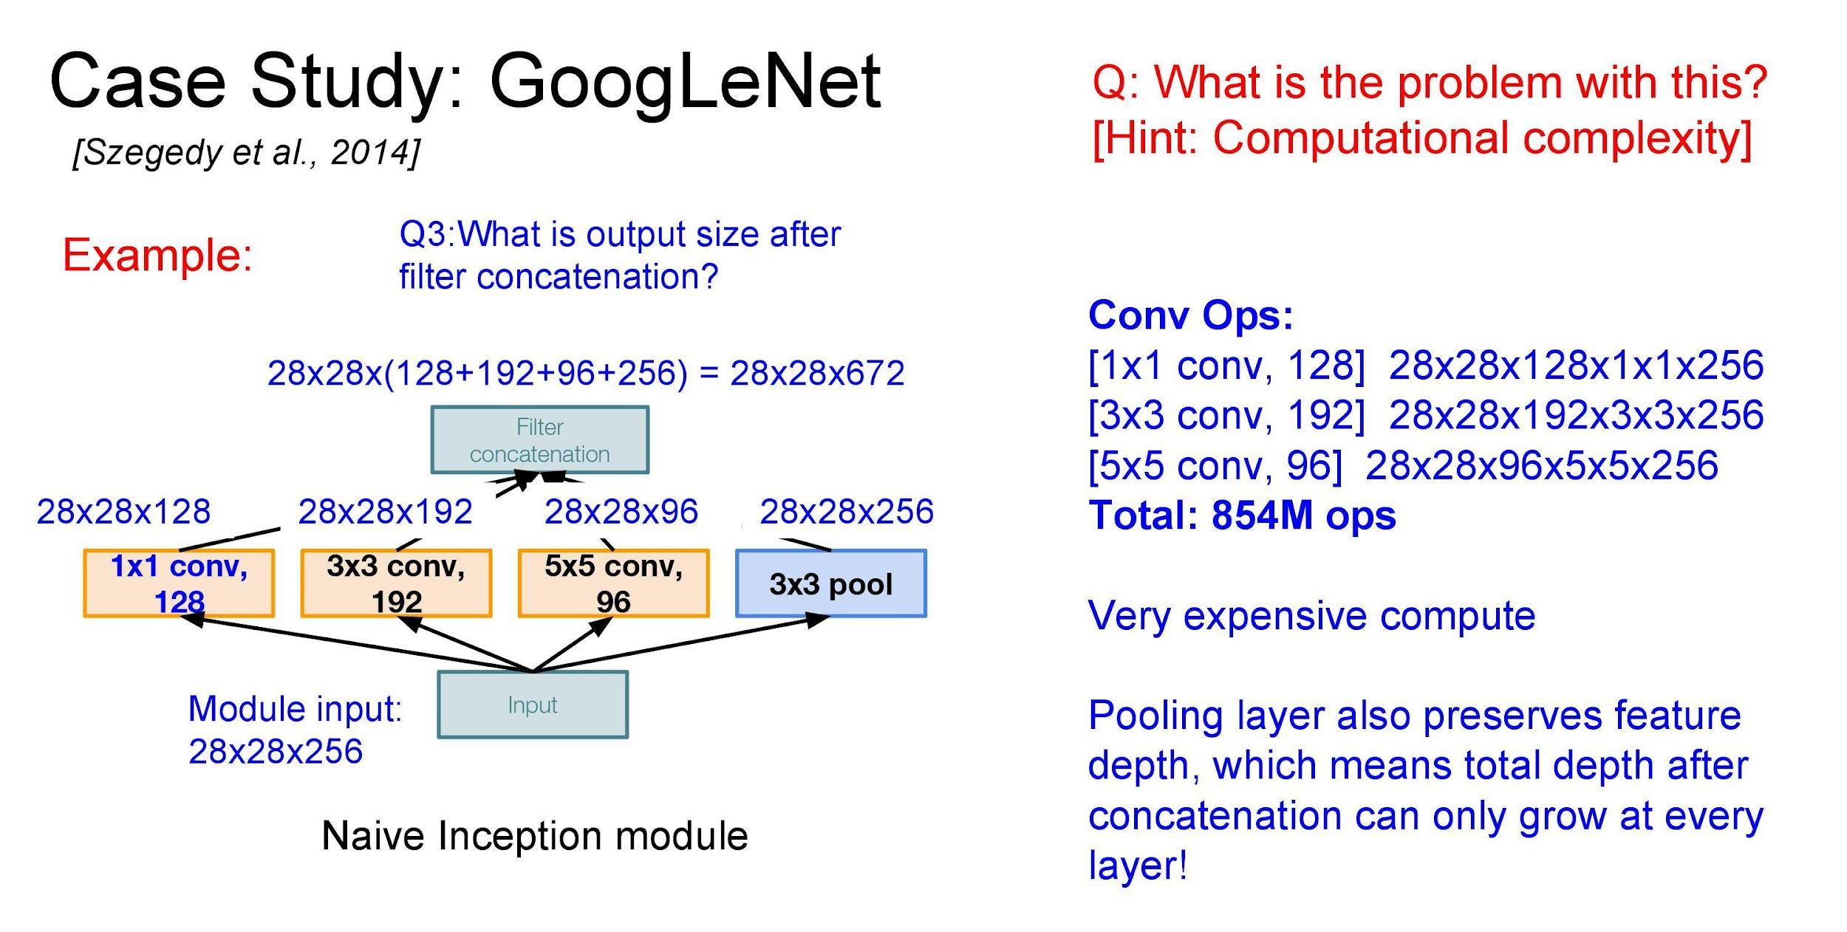

Slide 36
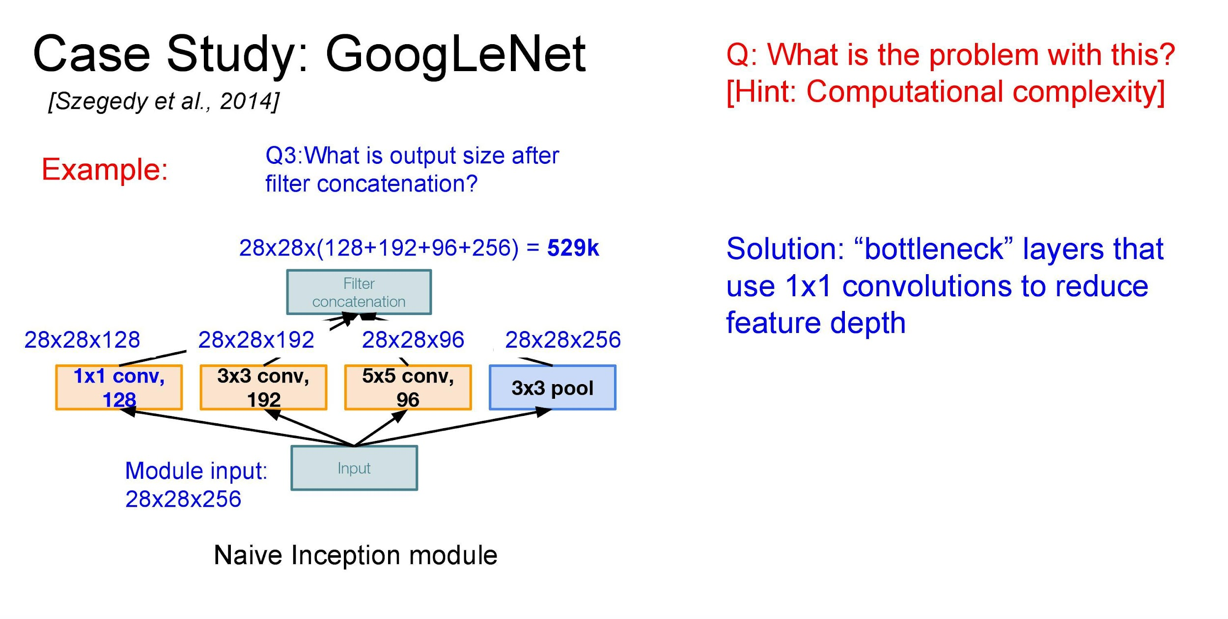

Slide 37
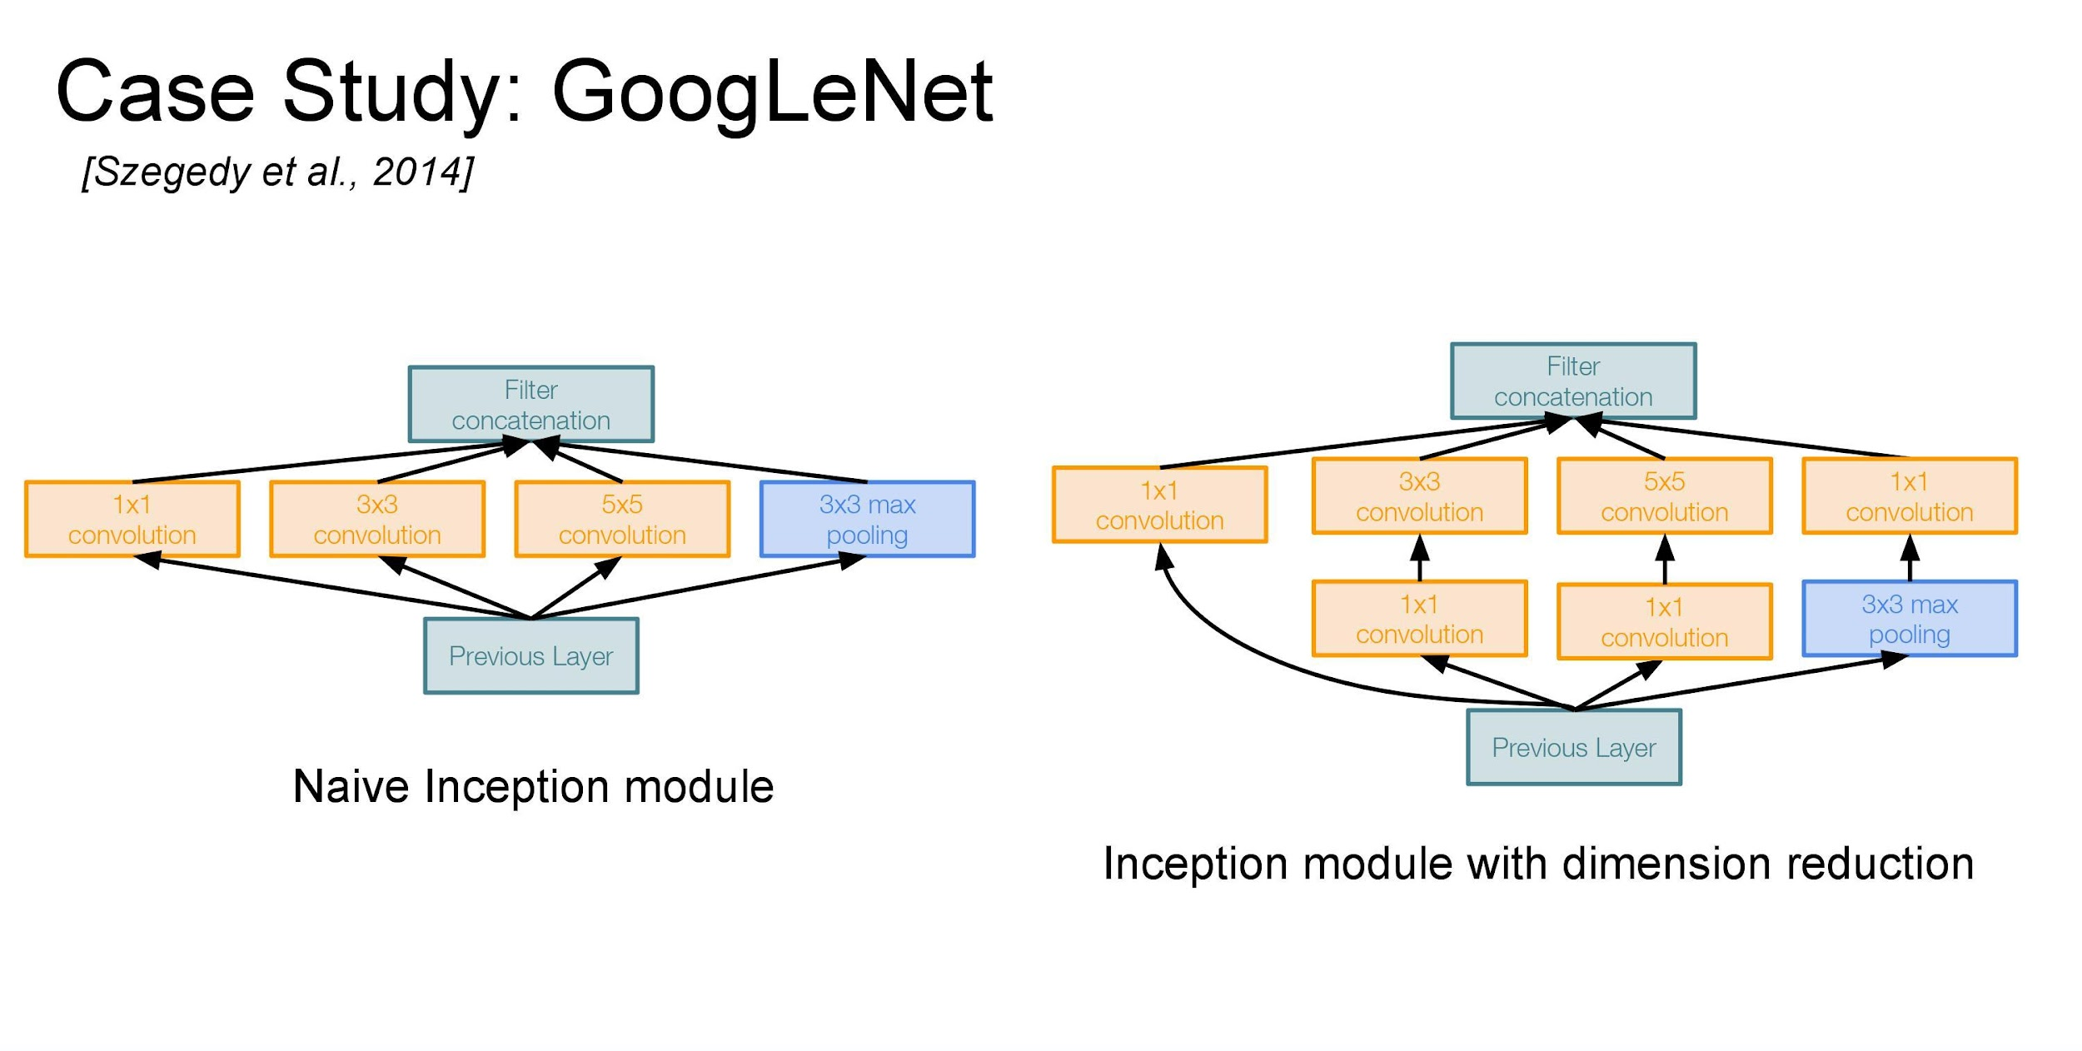

Slide 38
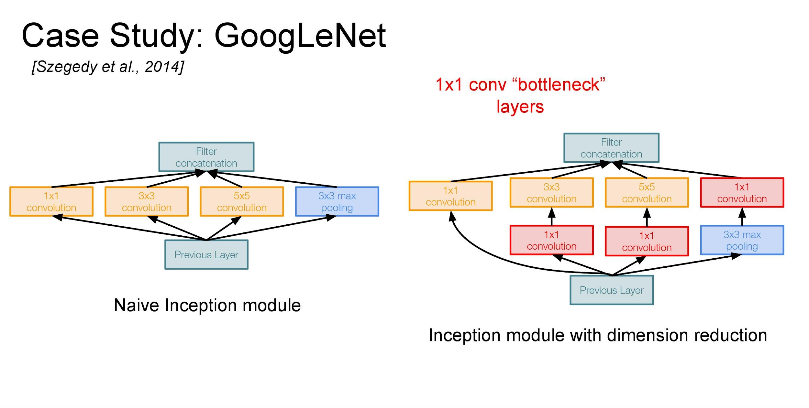

Slide 39
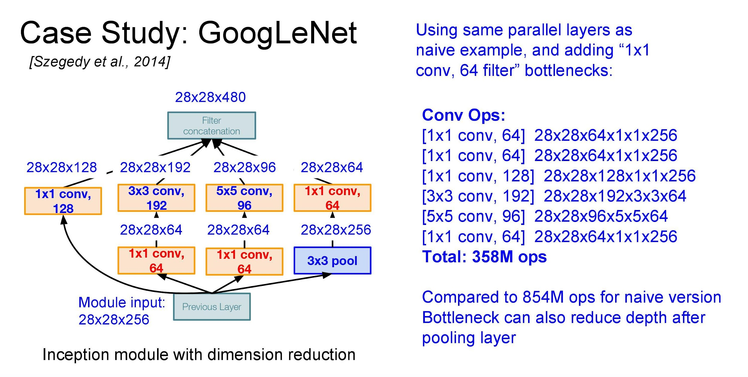

Slide 40
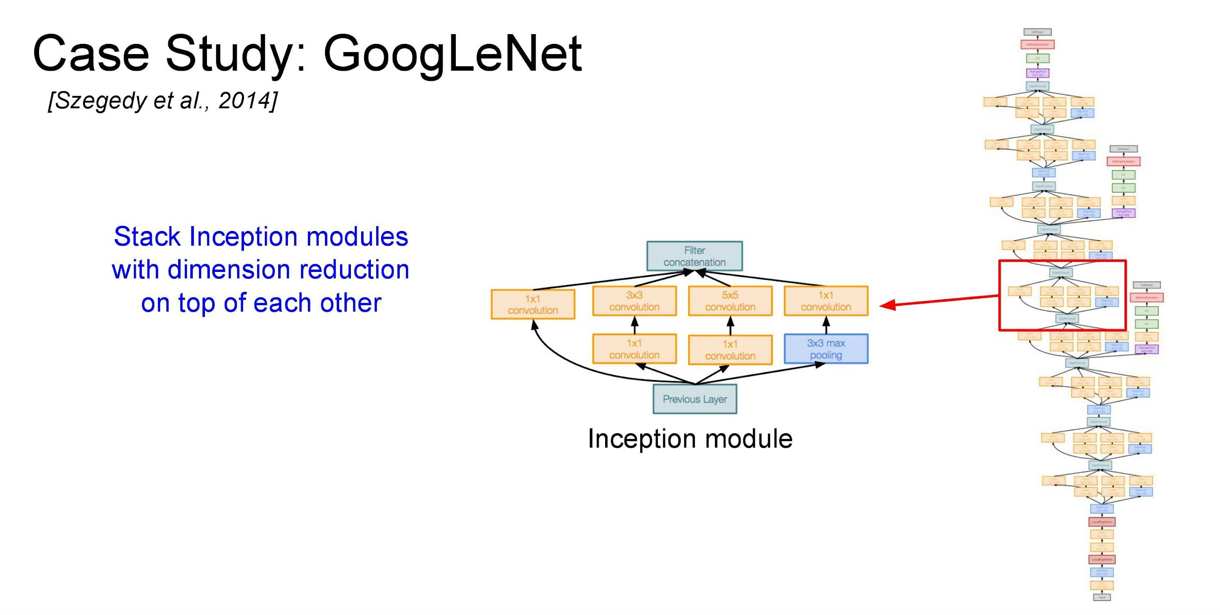

Slide 41
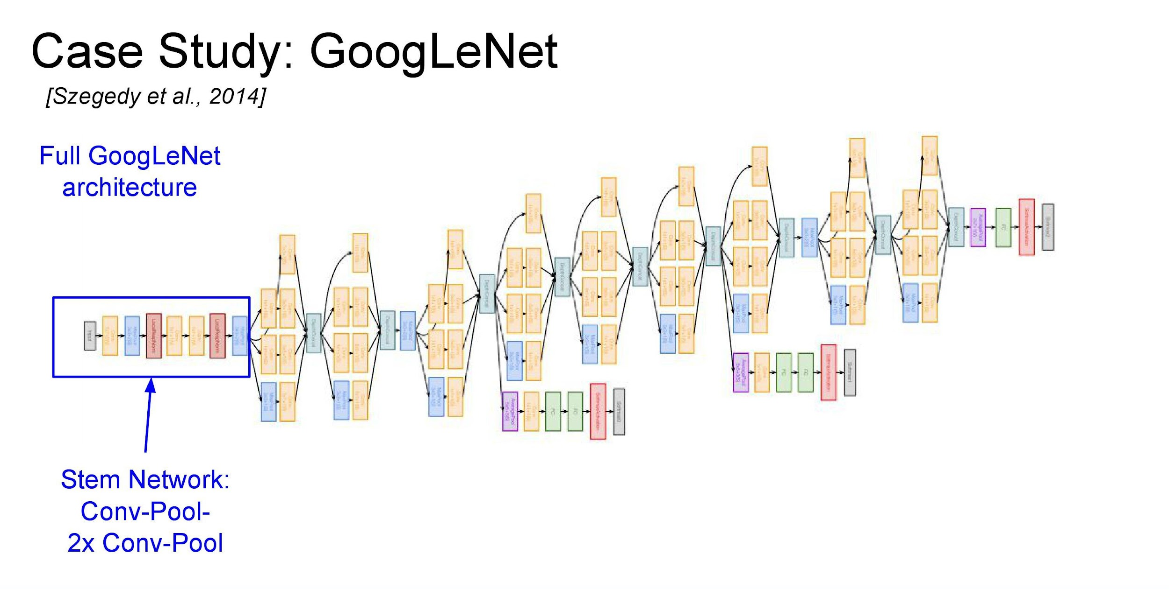

Slide 42
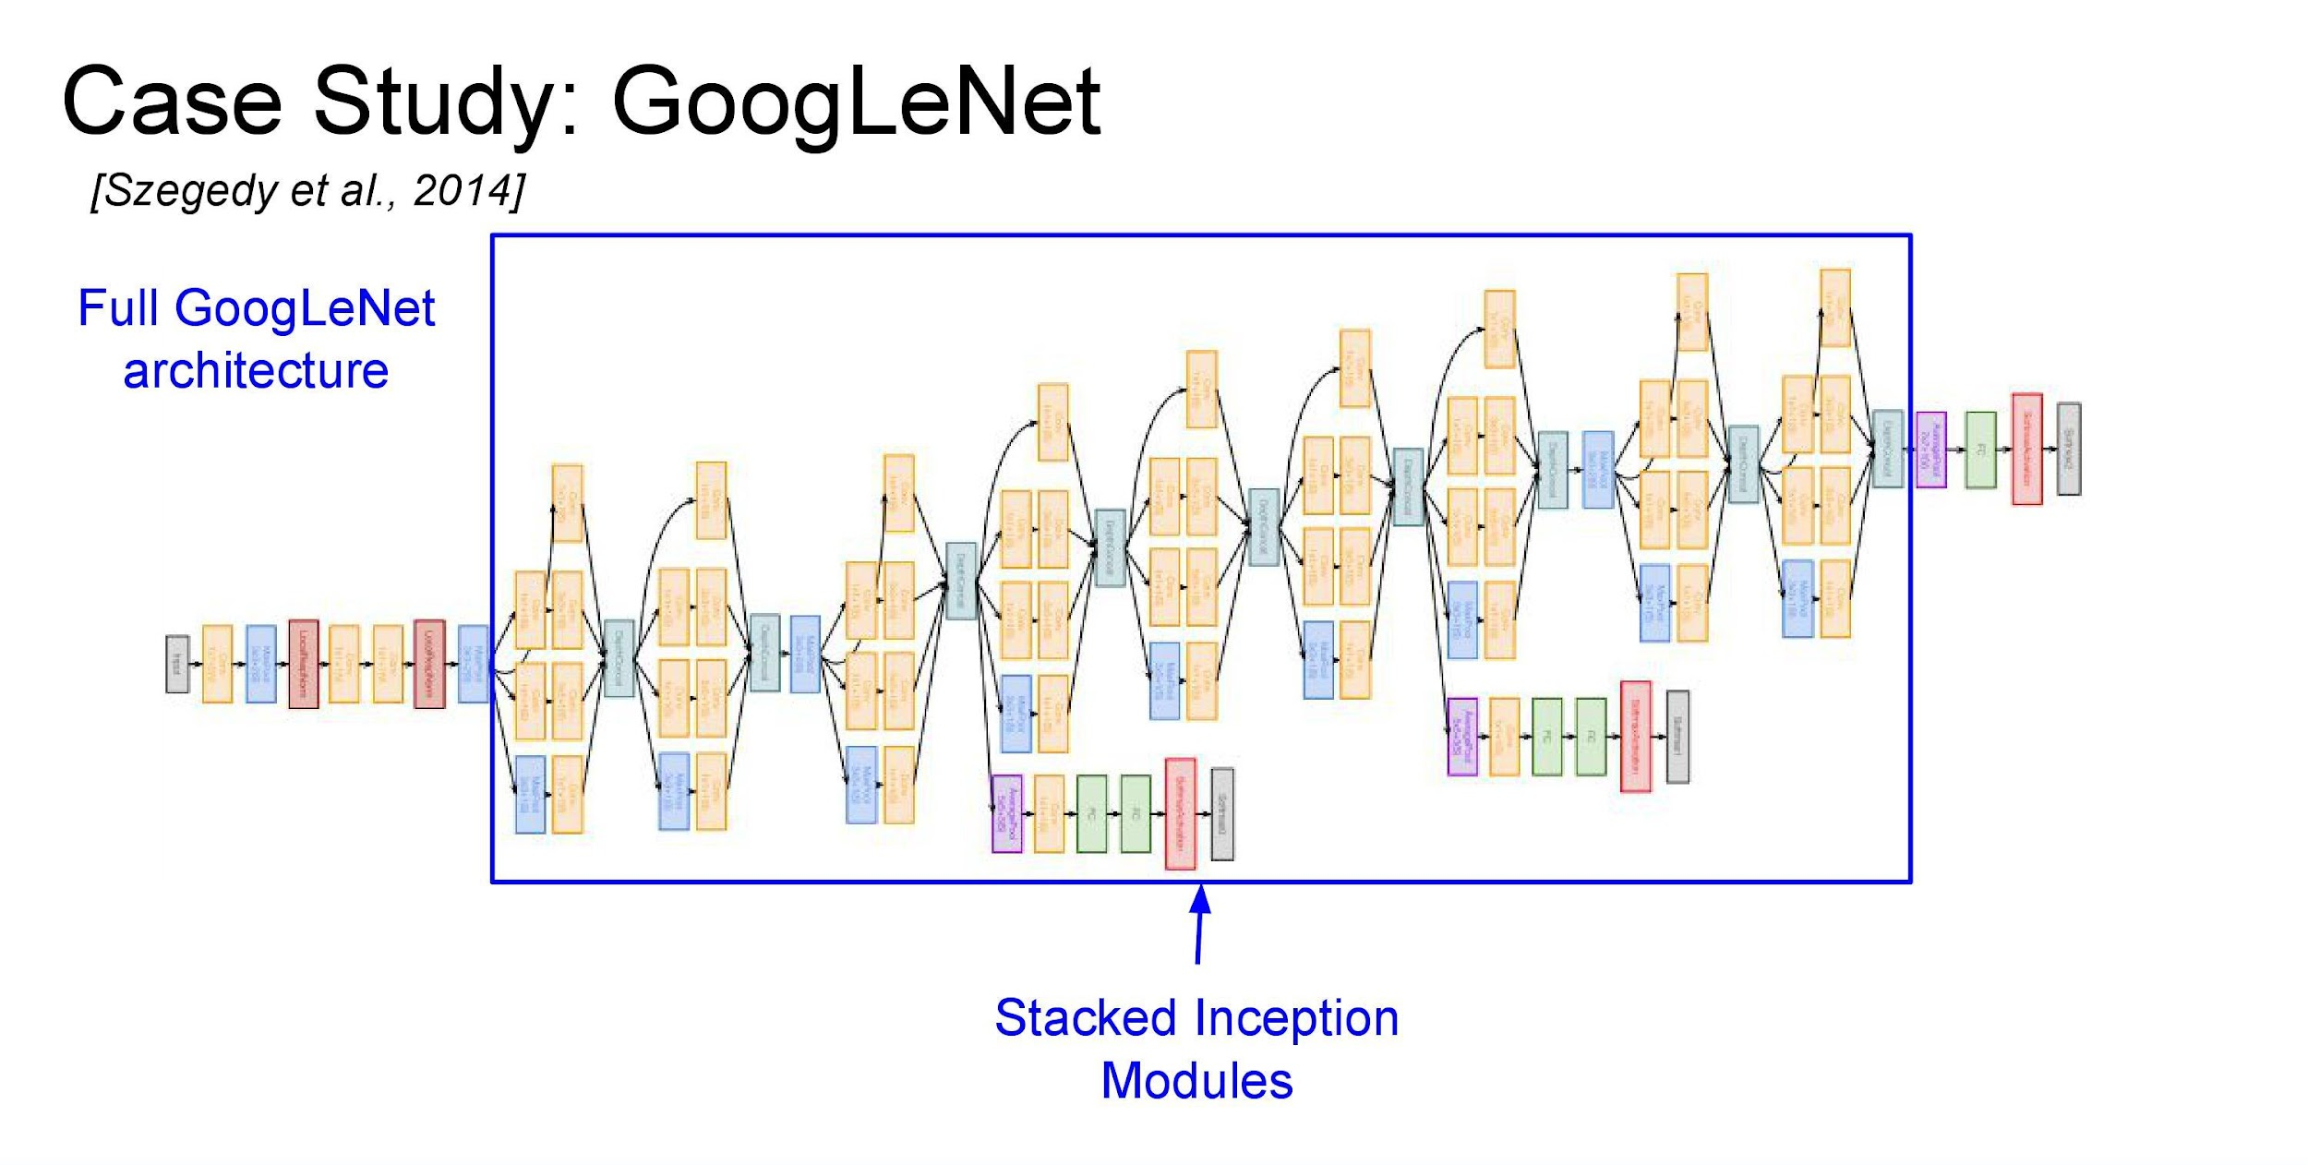

Slide 43
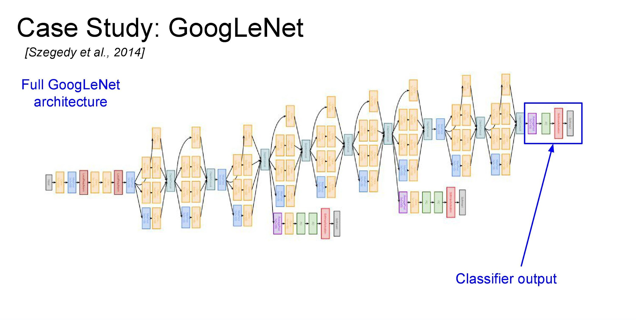

Slide 44
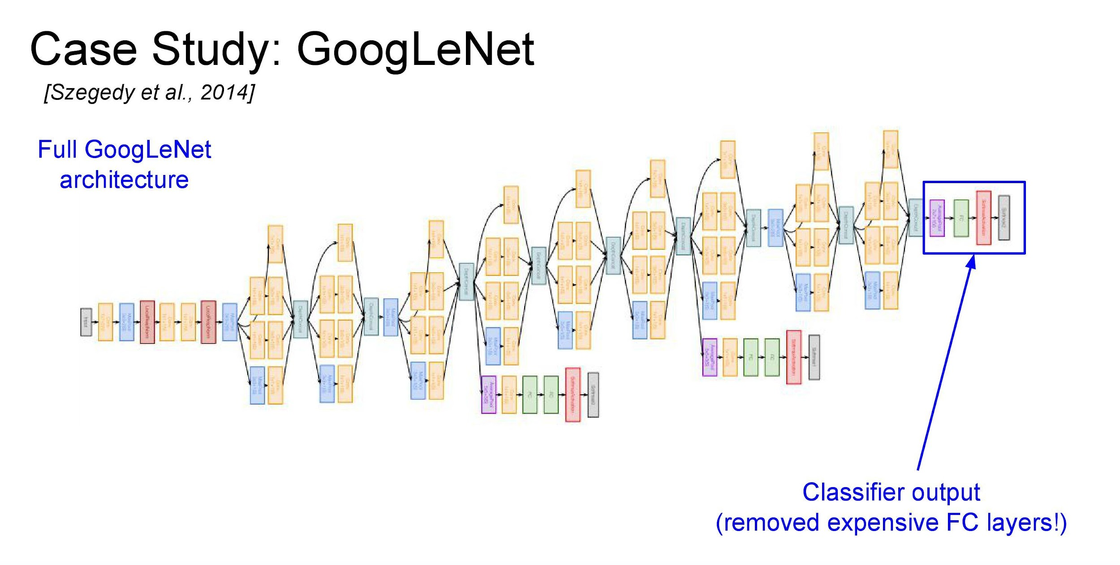

Slide 45
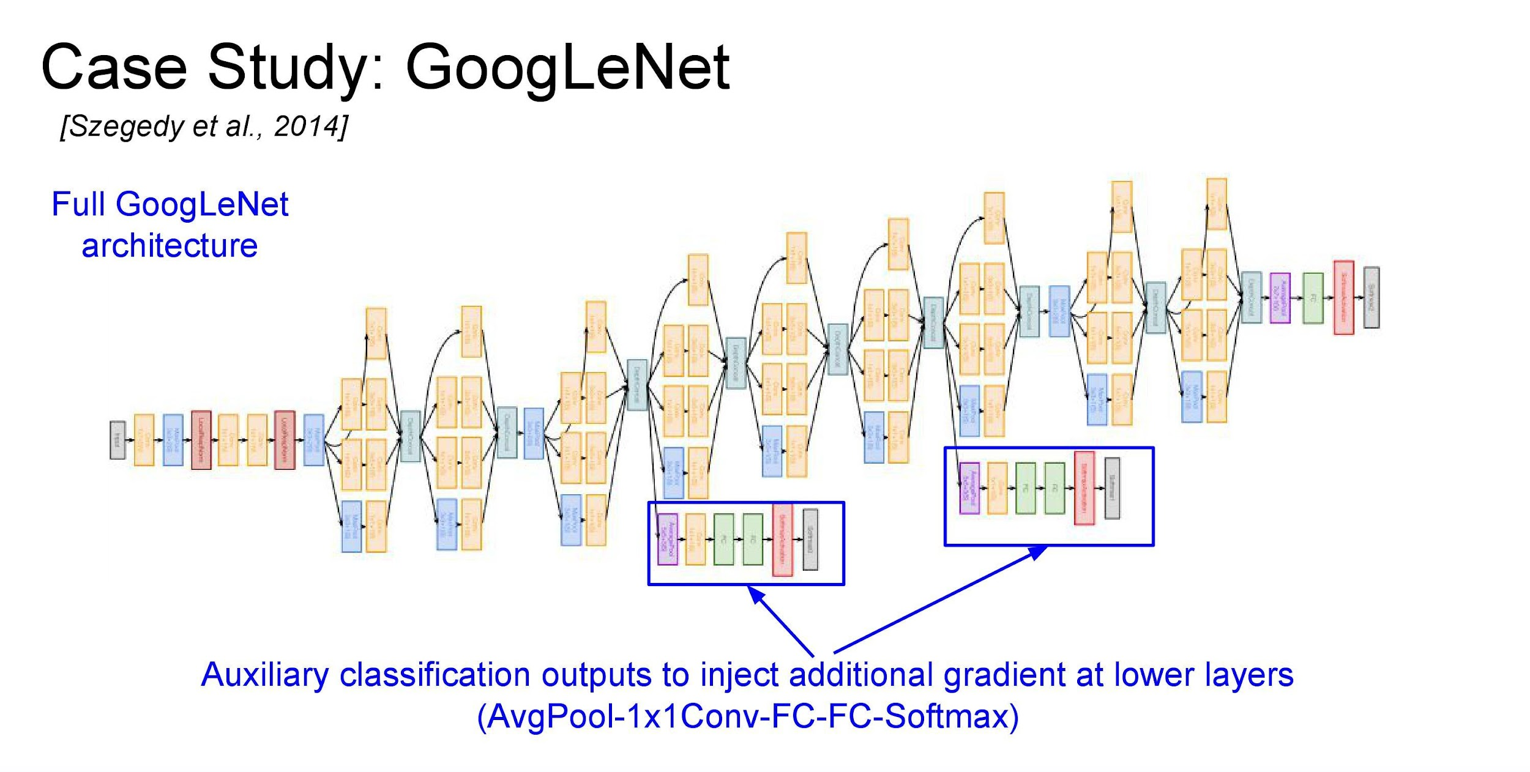

Slide 46
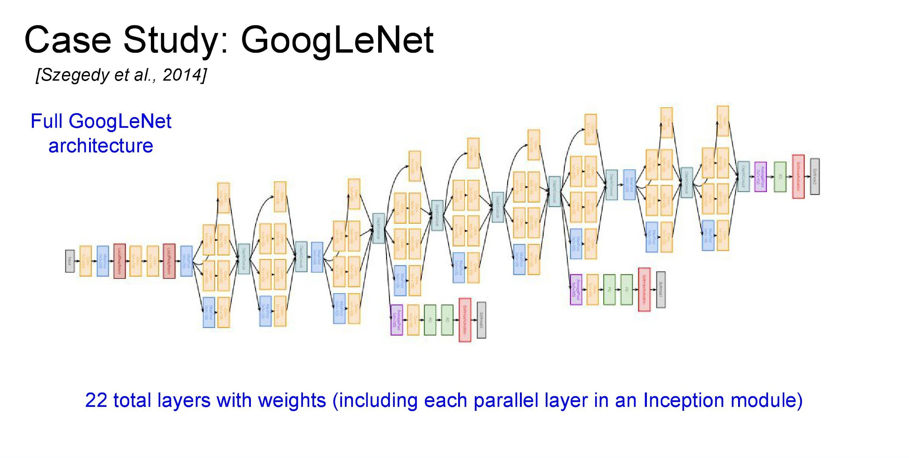

Slide 47
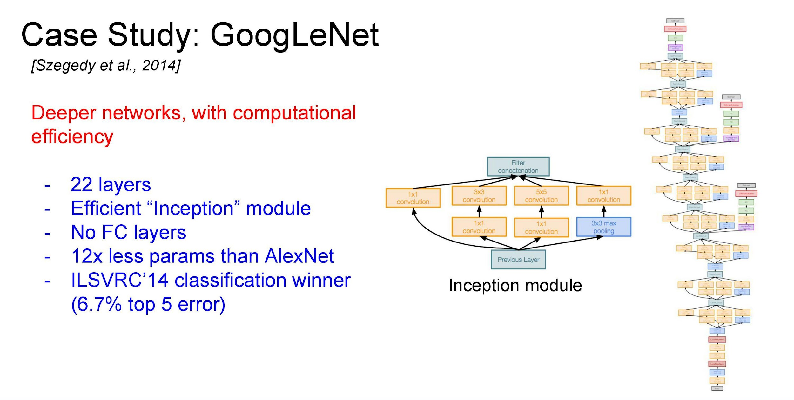

Slide 48


Slide 49


Slide 50


Slide 51


Slide 52


Slide 53


Slide 54


Slide 55


Slide 56


Slide 57


Slide 58


Slide 59

Notes:
https://towardsdatascience.com/difference-between-local-response-normalization-and-batch-normalization-272308c034ac#:~:text=Local%20Response%20Normalization%20(LRN)%20was,and%20sigmoid%20at%20that%20time.&text=LRN%20is%20a%20non%2Dtrainable,a%20within%20a%20local%20neighborhood.

Slide 60


Slide 61


Slide 62
Summary: Object Recognition
Deep learning
LeNet by Lecun et al. 1998 (MNIST)
AlexNet by Krish et al. NIPS’ 12
VGGNet by Simonyan et al. ICLR’ 15
GoogLeNet by Szegedy et al. CVPR’ 15
ResNet by He et al., CVPR’ 16
Slide credit: Kaiming he

